Slide 1
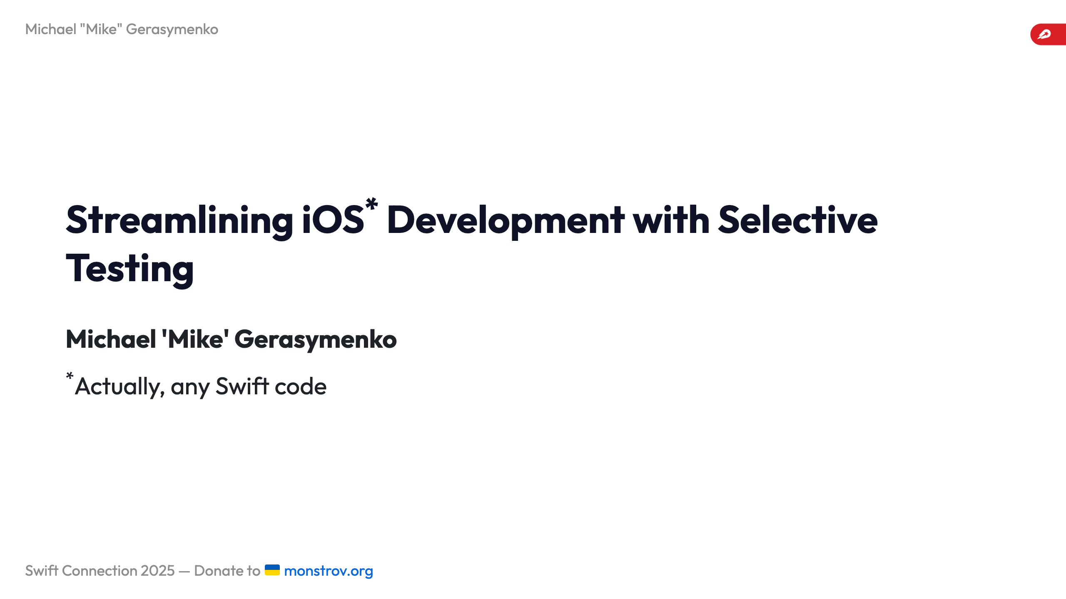
Notes:
Comments - Time is limited - Introduction can be shorter (could be cut for time) - Mention swift testing / XCTest compatibility - 10 min session, 5 min Q/A ![width:250](images/logo_dh_logistics.png) ![bg right:42%](images/background_anim.gif)

Slide 2


Slide 3


Slide 4


Slide 5


Slide 6


Slide 7

Notes:
--- # Who I am Hey, I'm Michael. I am originally from Ukraine 🇺🇦, based in Berlin 🇩🇪 Started as an iOS engineer in 2009: - Readdle - Wire - Cara Care - Feeld Github: [mikeger](https://github.com/mikeger) Web: https://gera.cx ![bg right:33%](images/mike-hat.jpg) --- # Where I work Today, a Staff iOS engineer at Delivery Hero Logistics: - Available in 70-something countries - Serving over a million delivery drivers monthly ![bg 100% right:33%](images/brands.png)

Slide 8
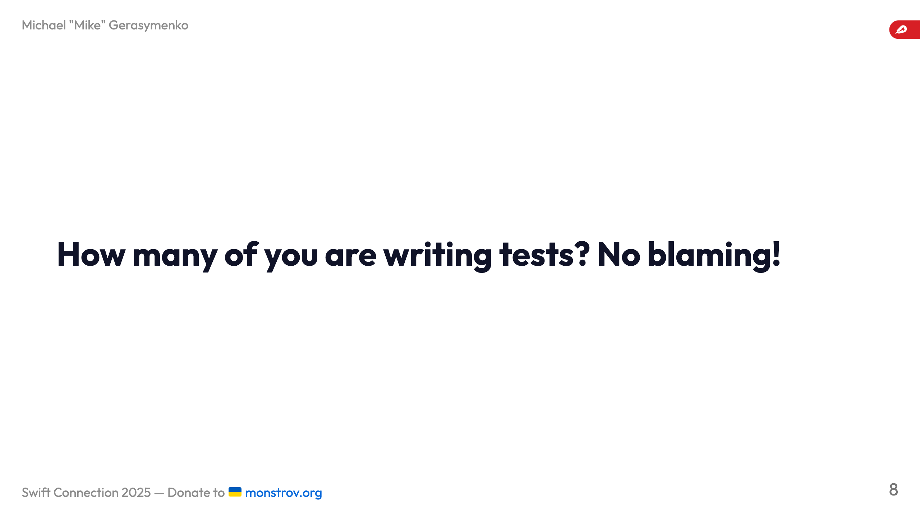

Slide 9
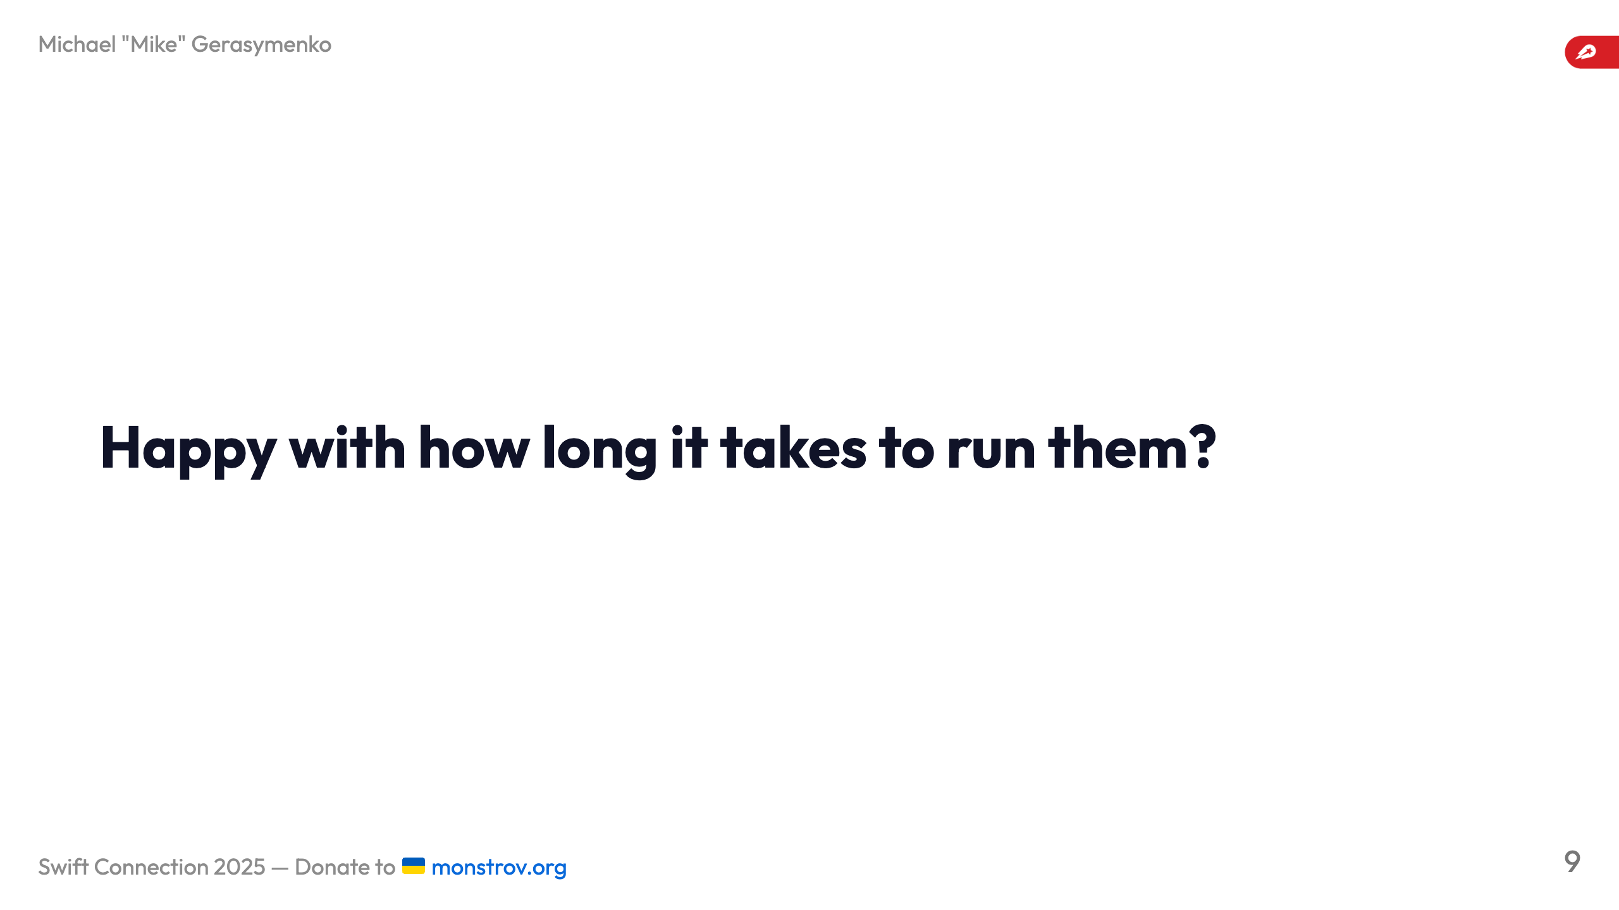

Slide 10
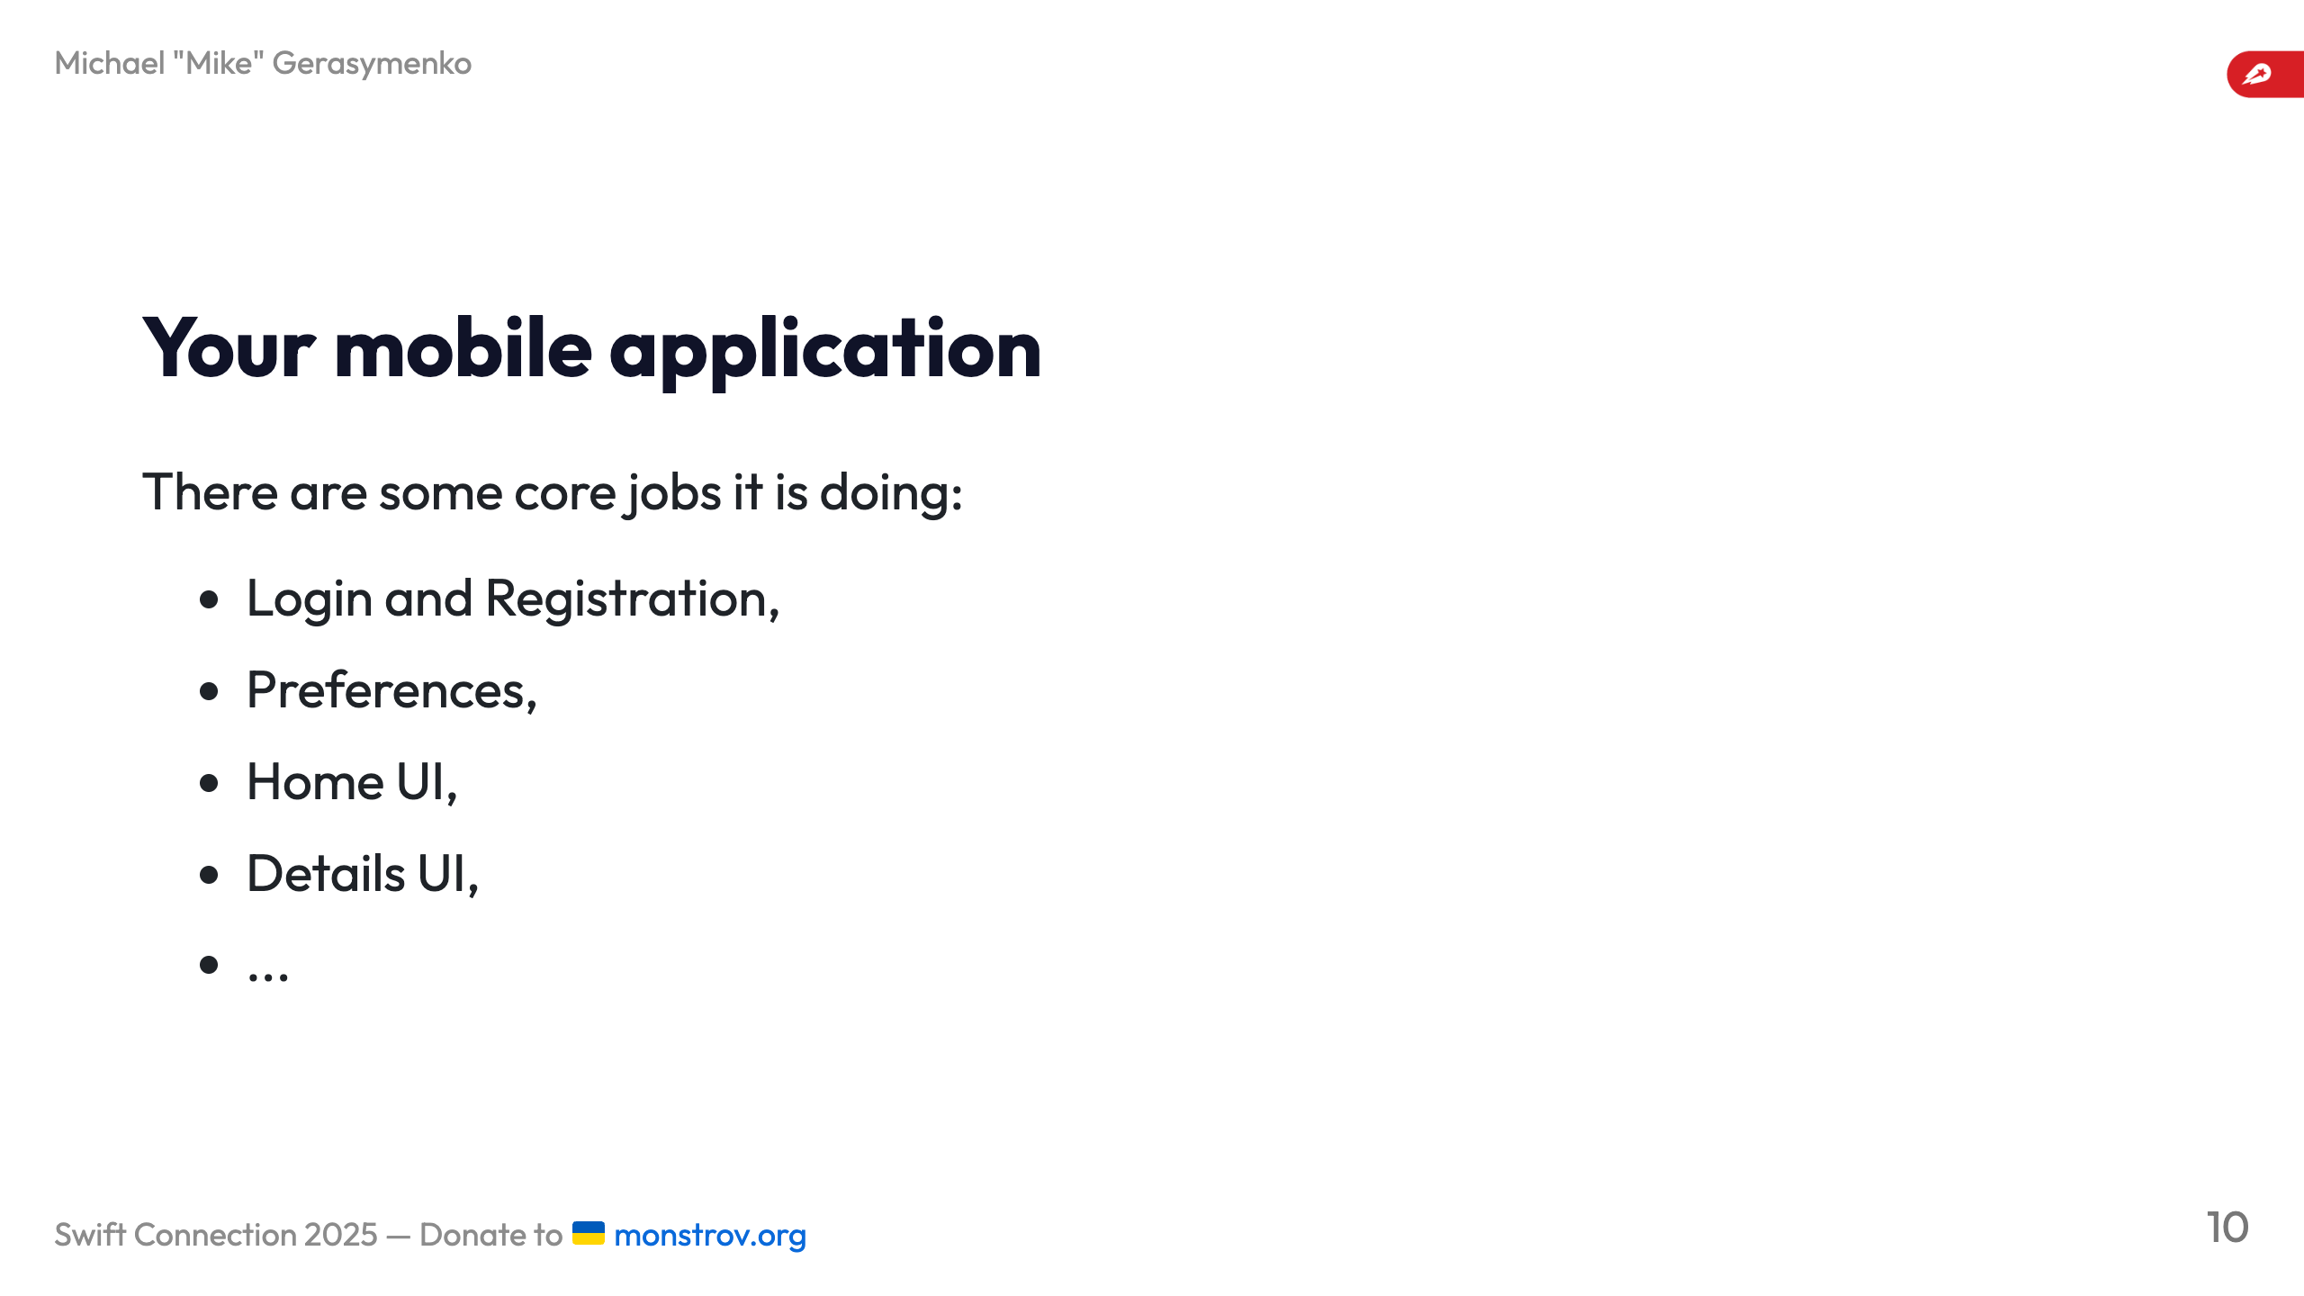

Slide 11
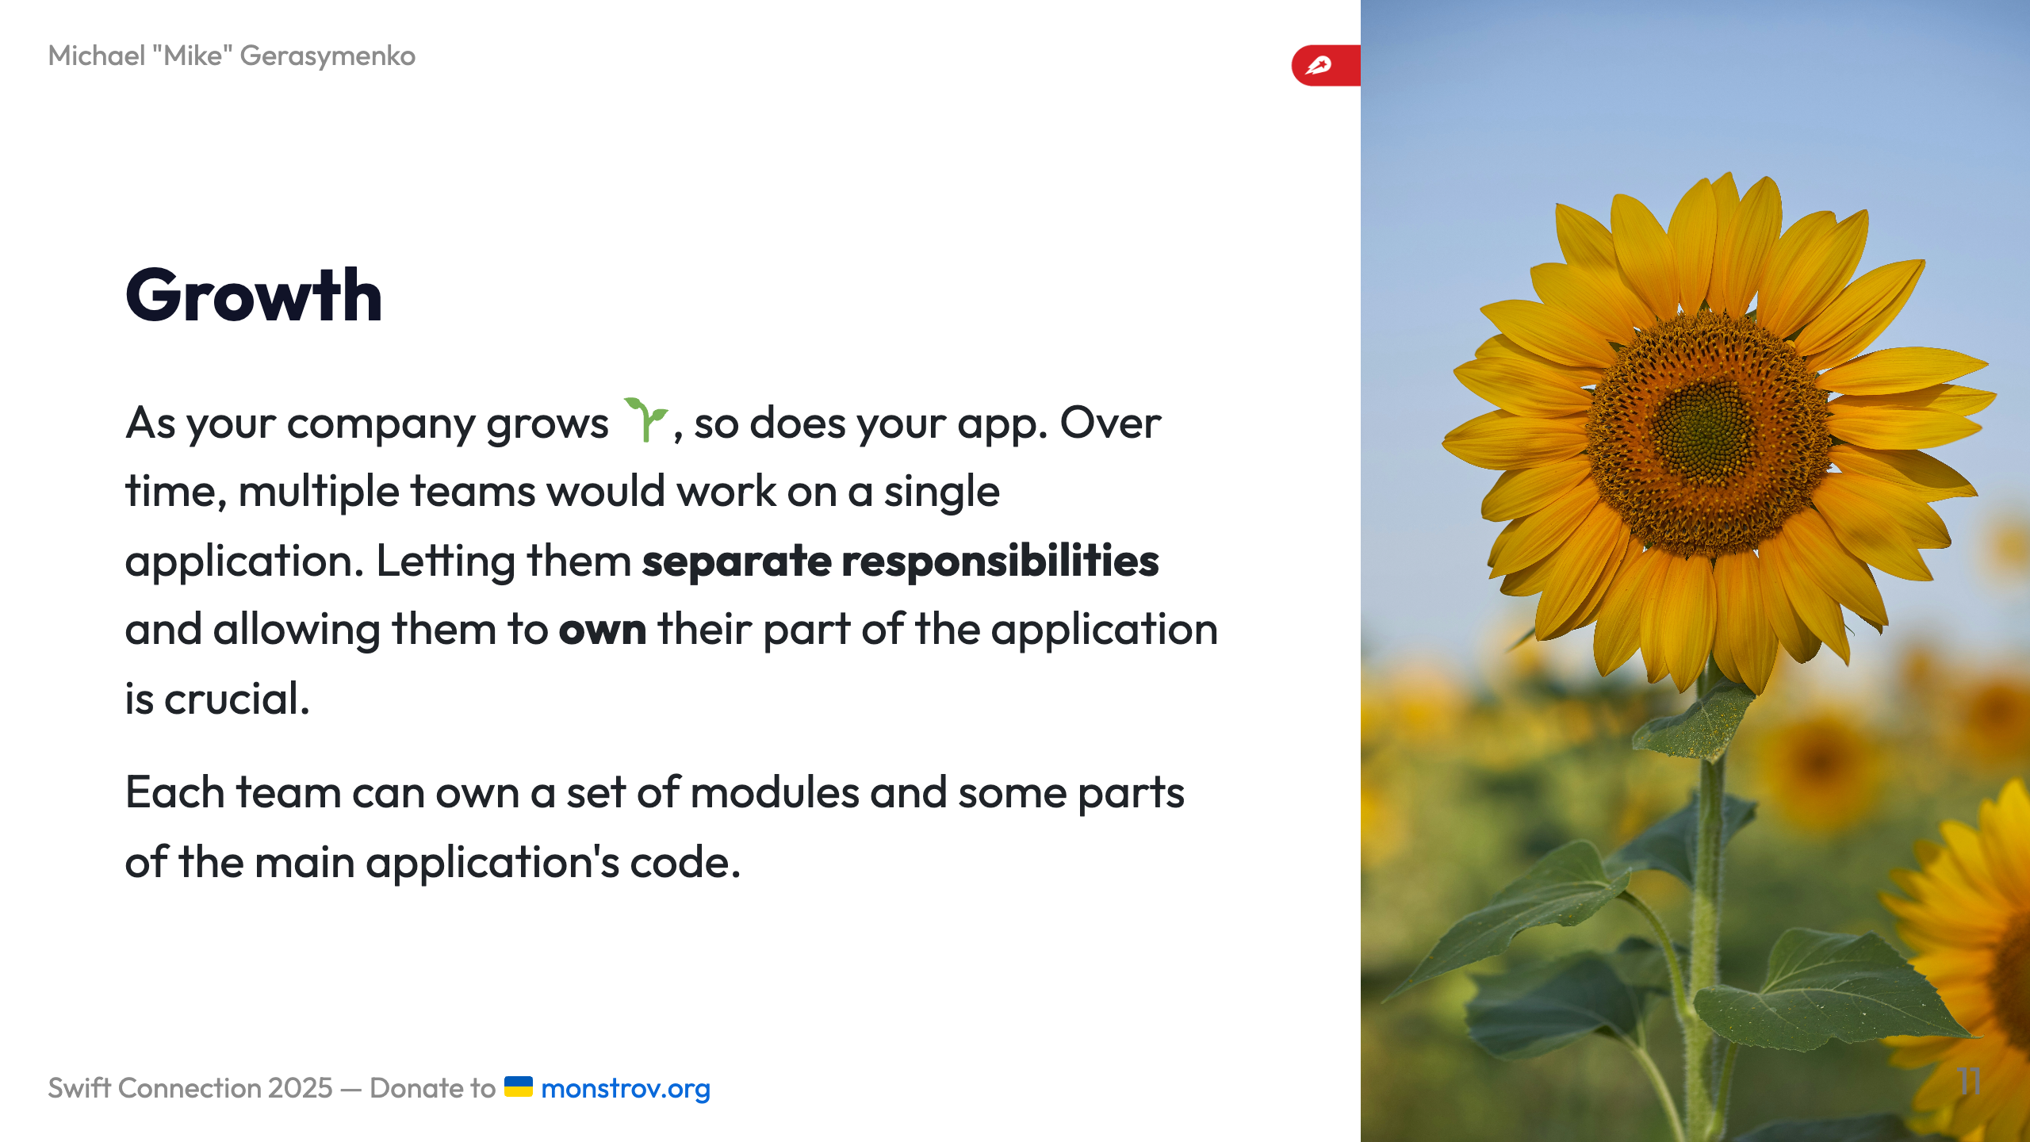
Notes:
--- ![bg left:33%](images/nodes.webp)

Slide 12
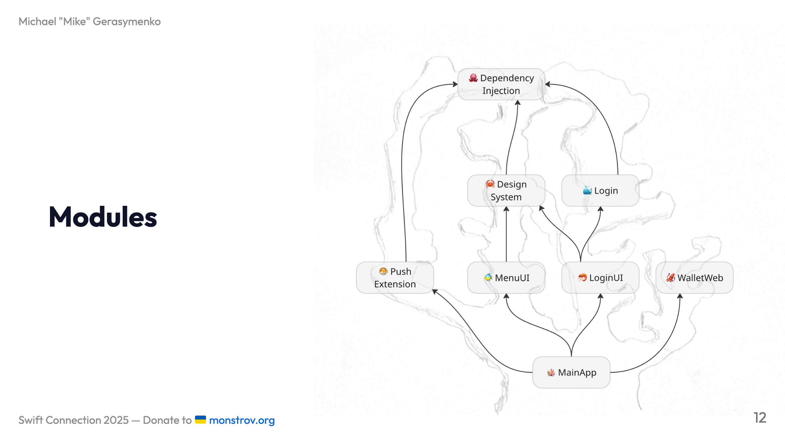
Notes:
# External dependencies Your application probably already has some external dependencies, which are also modules: - Crash reporting - Analytics - ... --- # Some internal functionality can be separated as a module, too For example: - Dependency Injection - Networking and Authentication - Localization - CommonUI, aka Design System You can treat them as internally developed libraries. # Swift Package Manager or Projects/Targets? SPM and Xcode support local packages, which allows for lightweight modularization: ``` Packages/ ├── Networking/ │ ├── Package.swift │ ├── Sources │ └── Tests ├── Login/ ... ``` ![bg height:300 right:33%](images/swift-package-manager.png) # In Xcode - First-class citizen treatment: `Designed by Apple in California` - Xcode can handle many packages well - Dependencies between packages are supported - External dependencies are also supported ![bg left:33% height:300](images/xcode-spm.png) --- # Wait, there's more - Adding individual files to SPM packages does not cause project file to change: you can forget about `project.pbxproj` conflicts - You can open individual packages in Xcode to speed up the development - ... and you can do selective testing 🚀 --- # Congratulations, now you have a modular application ![bg left:33%](images/legos.jpg) <!-- --- > “Insanity is doing the same thing over and over and expecting different results.” Albert Einstein, probably ---

Slide 13
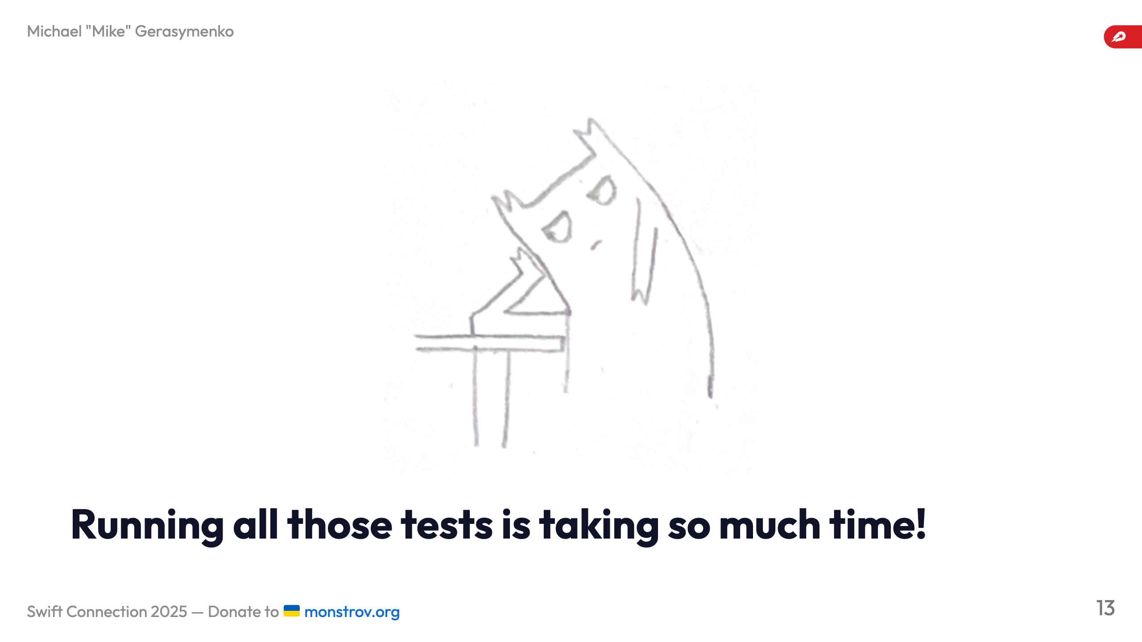

Slide 14
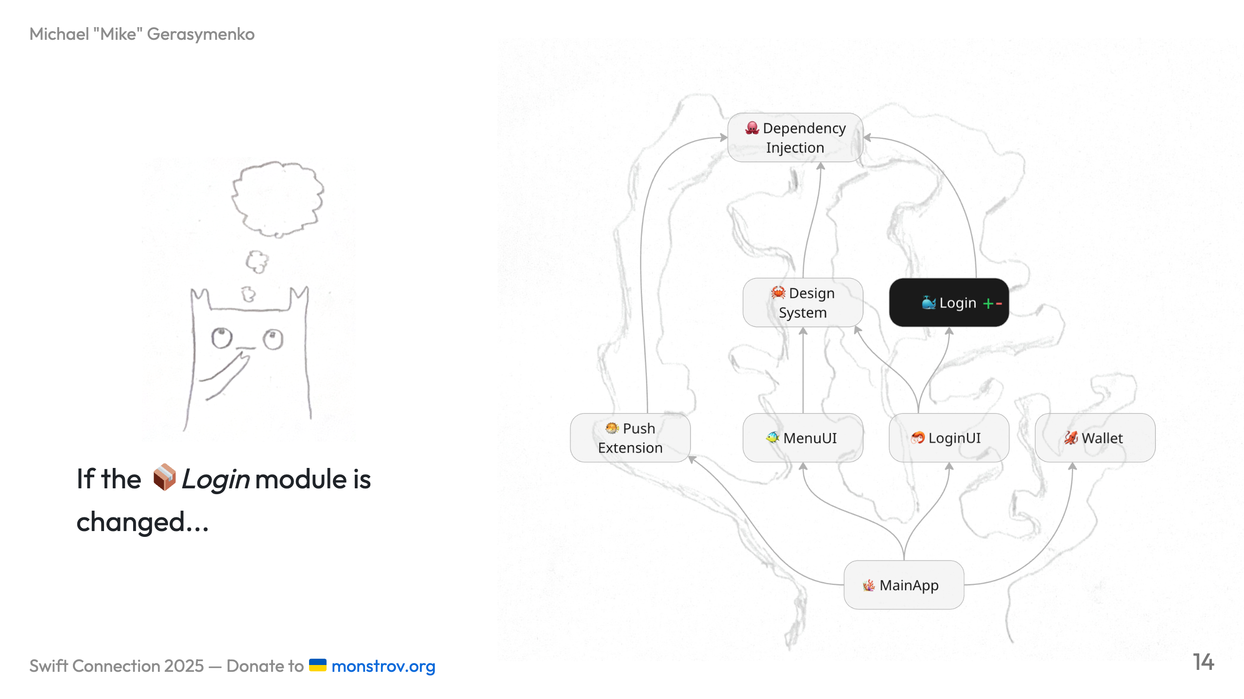

Slide 15
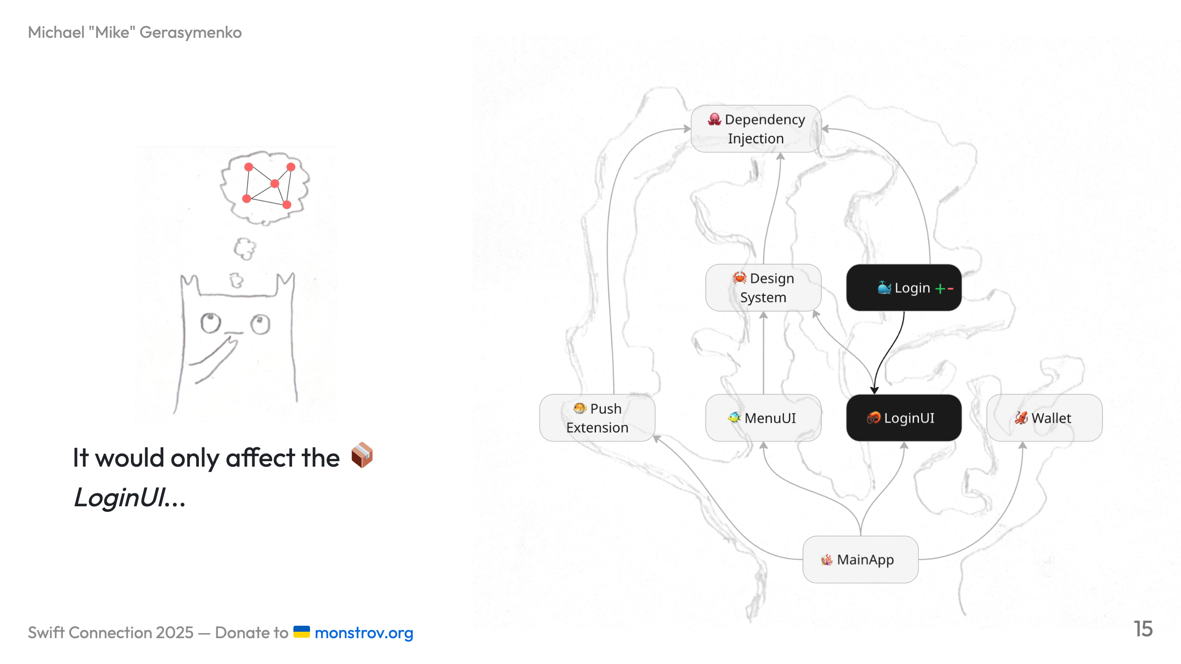

Slide 16
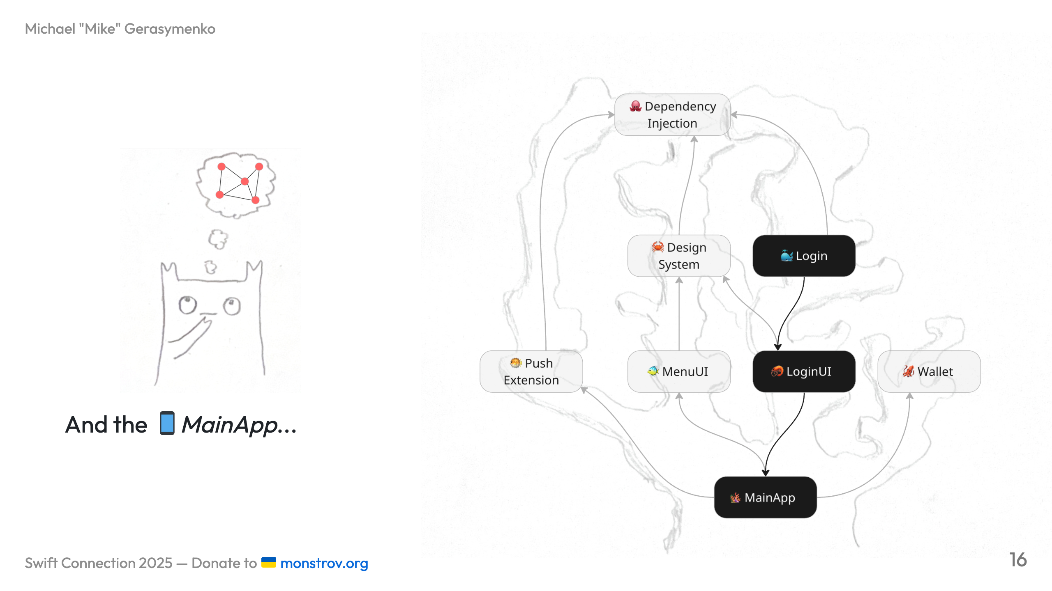

Slide 17
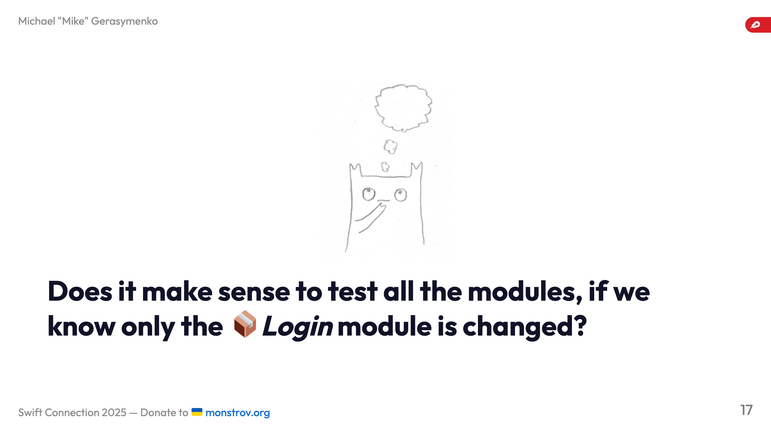

Slide 18
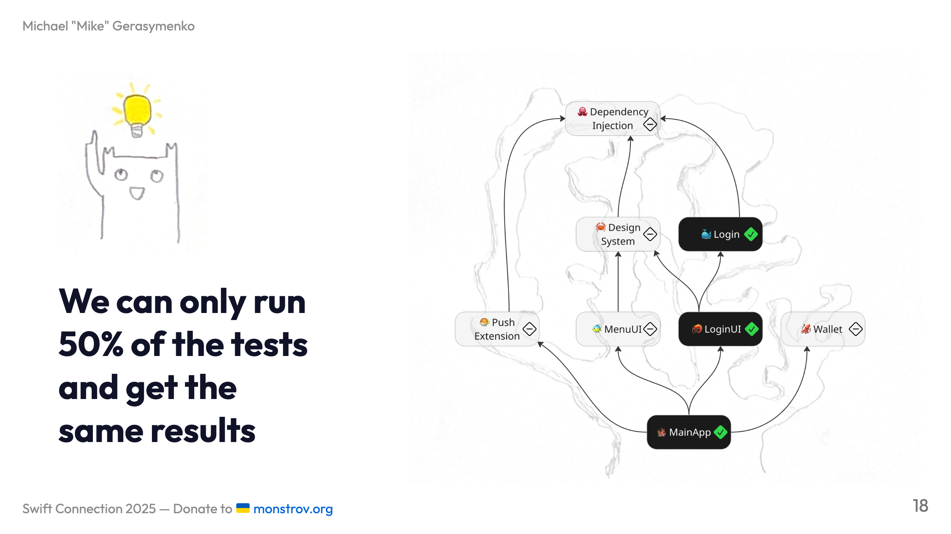

Slide 19
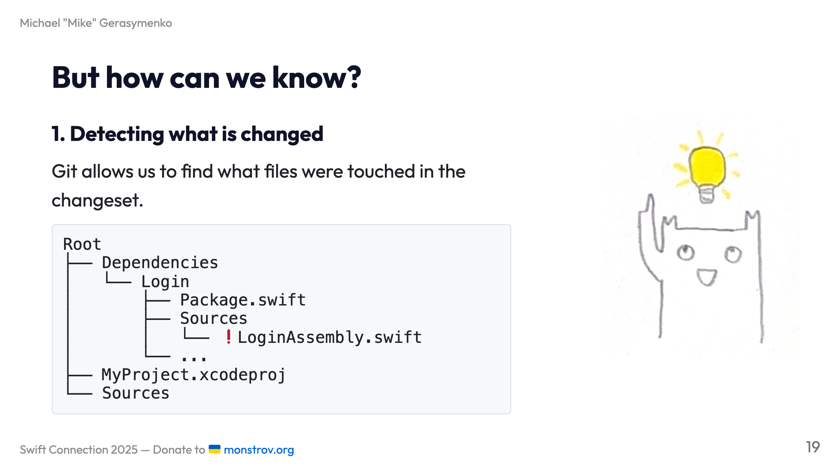

Slide 20
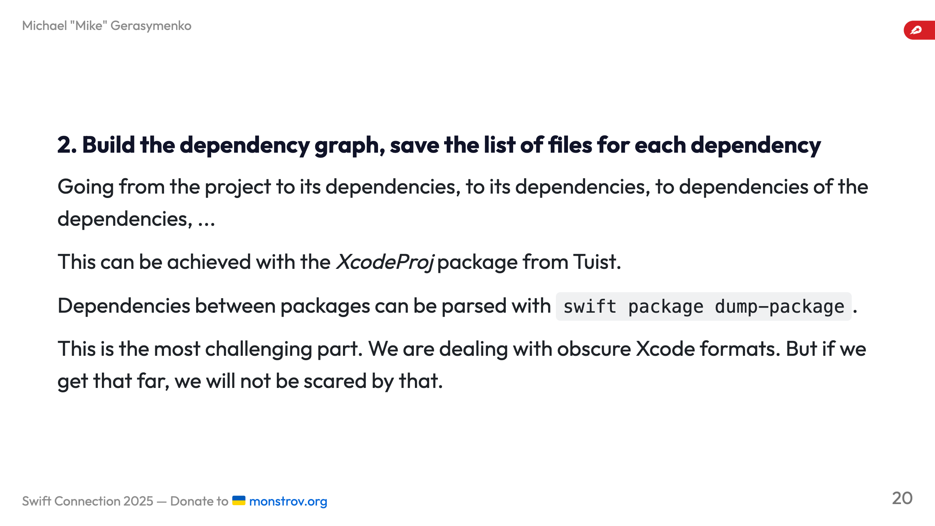

Slide 21
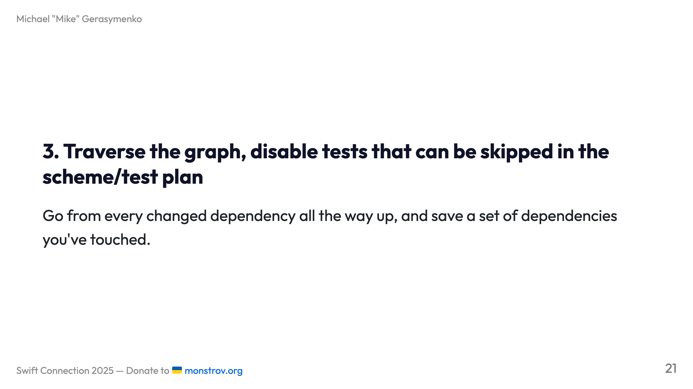

Slide 22
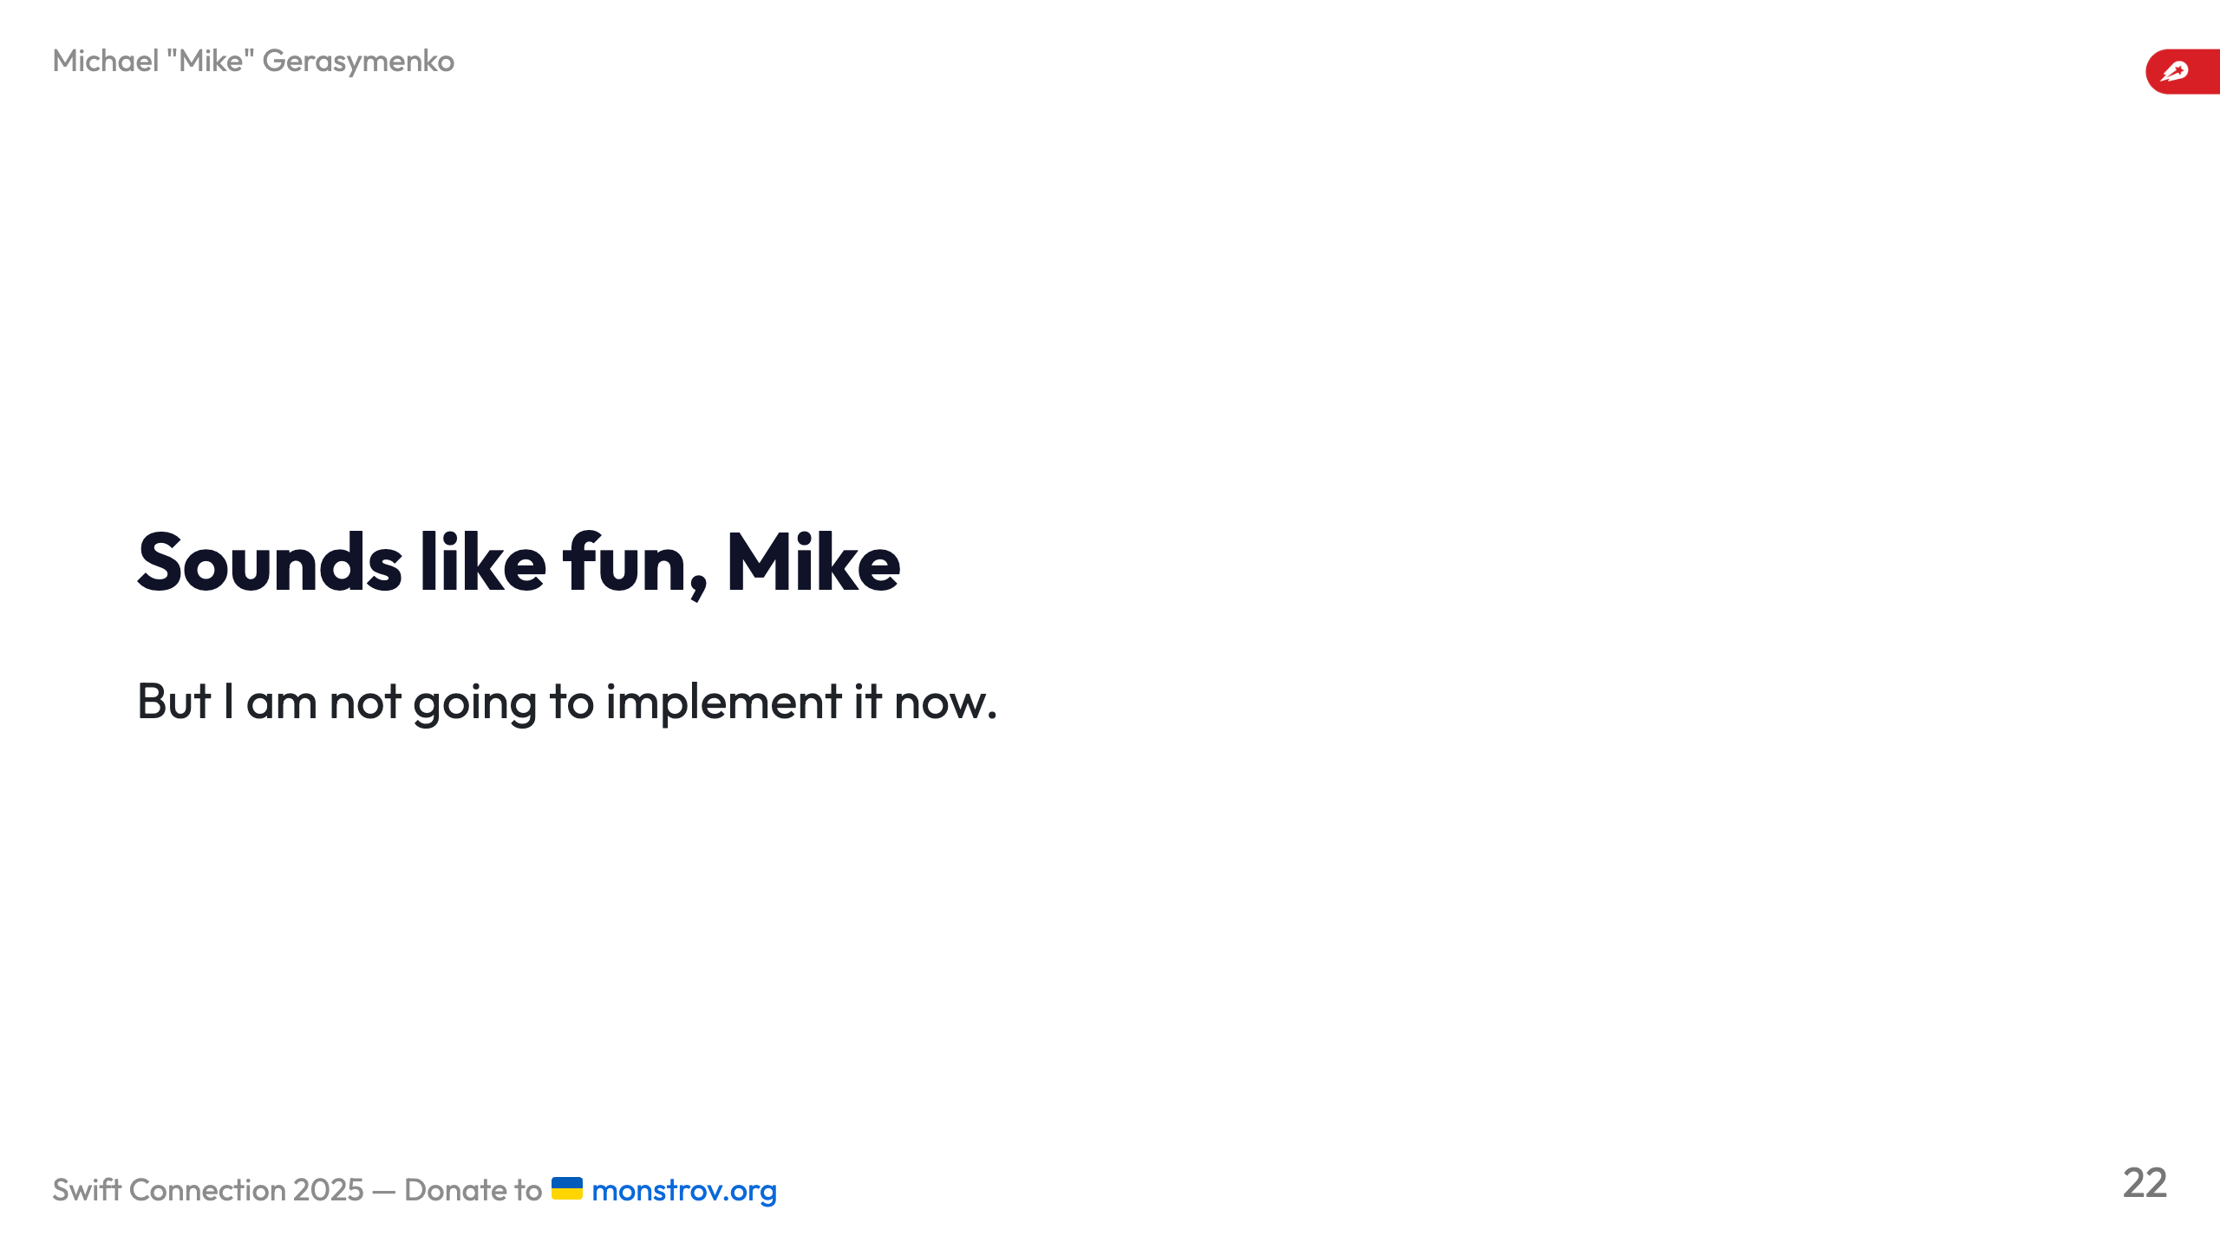

Slide 23
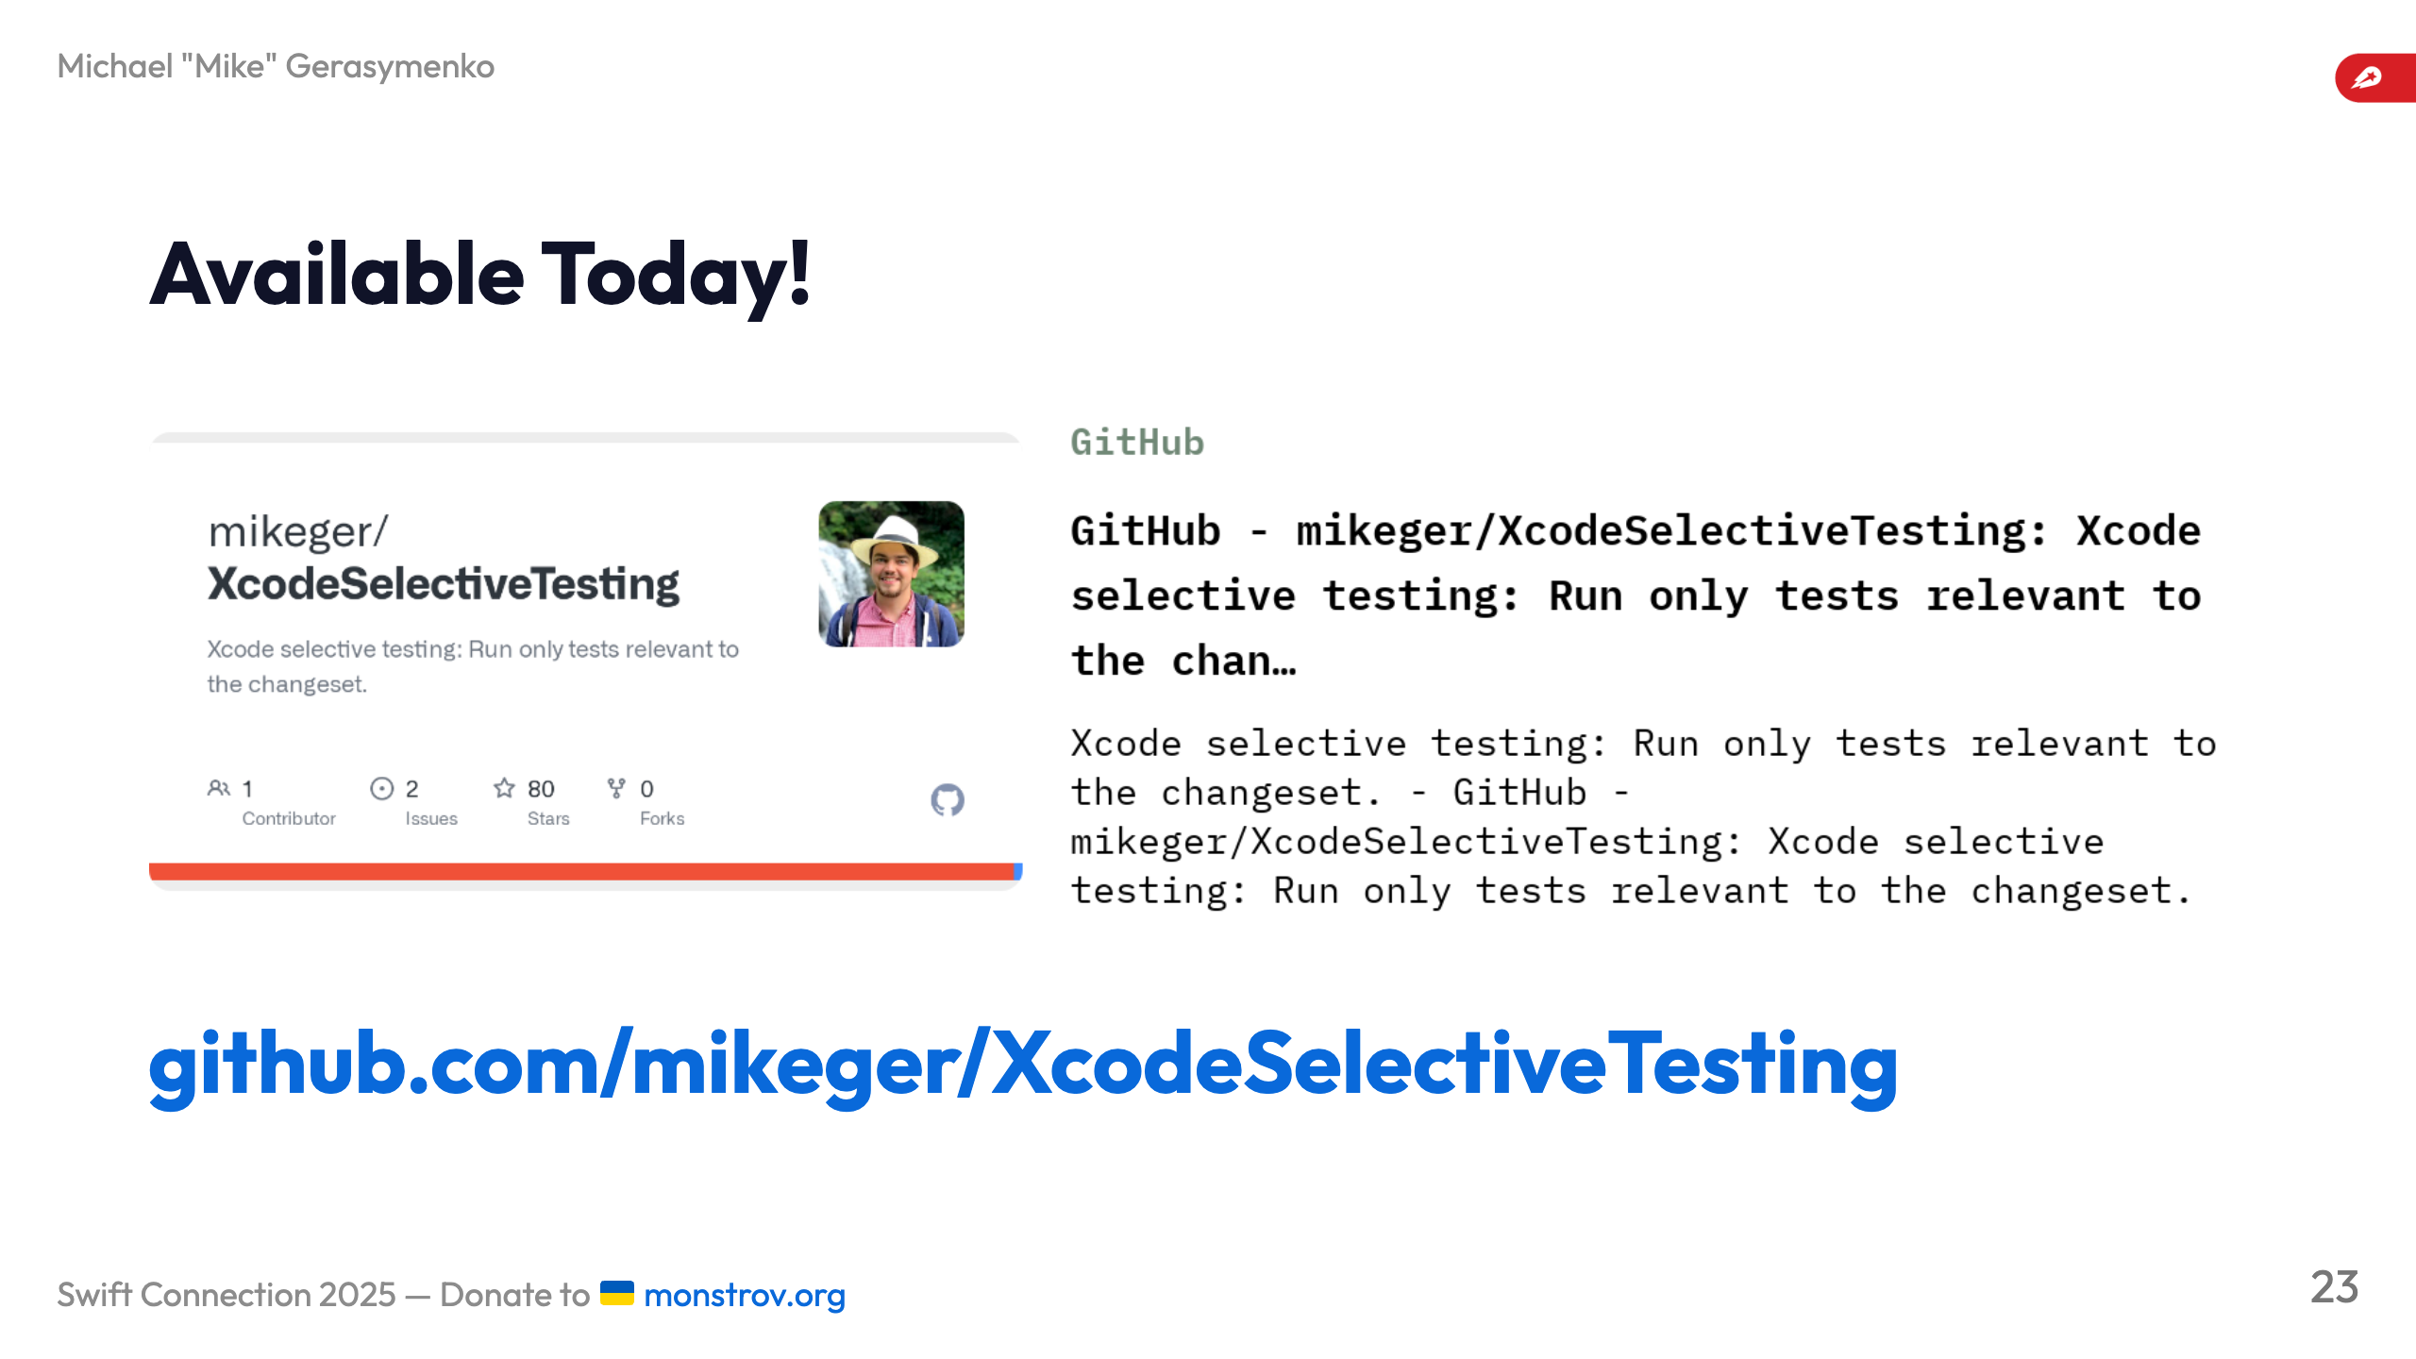
Notes:
![width:800 center](images/github.png)

Slide 24
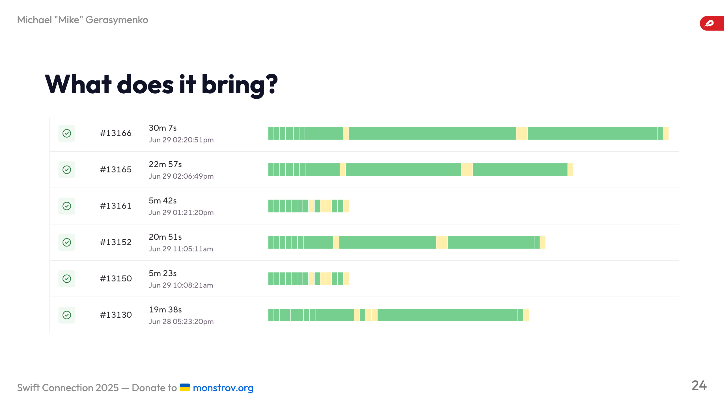
Notes:
We observed a 40-50% average CI time reduction when using XcodeSelectiveTesting. --- ![](images/test-changed-stats.png) --- # Why testing fast and precise is important? ![bg right width:480](images/compiling.png) - Faster CI run means consuming less natural resources - Local test runs are saving developer hours _header: ''

Slide 25
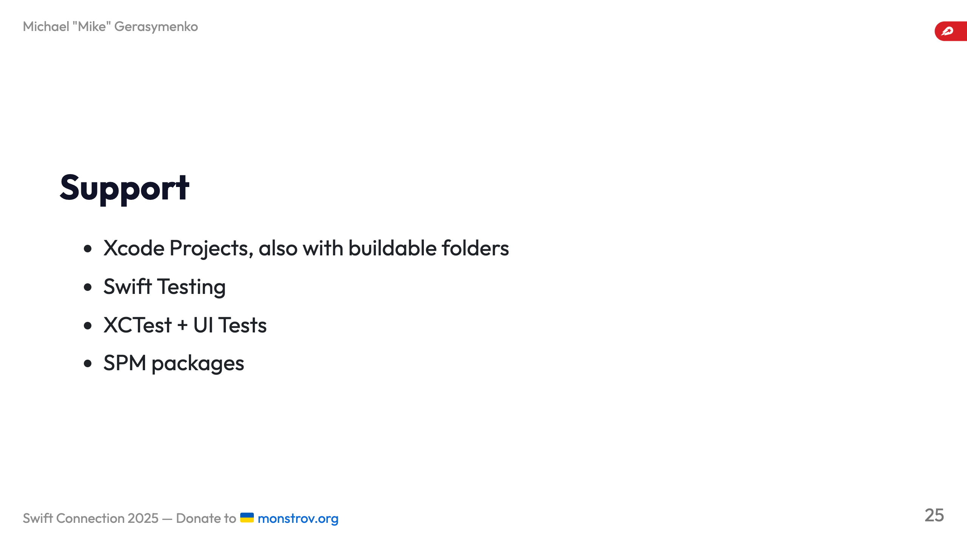

Slide 26
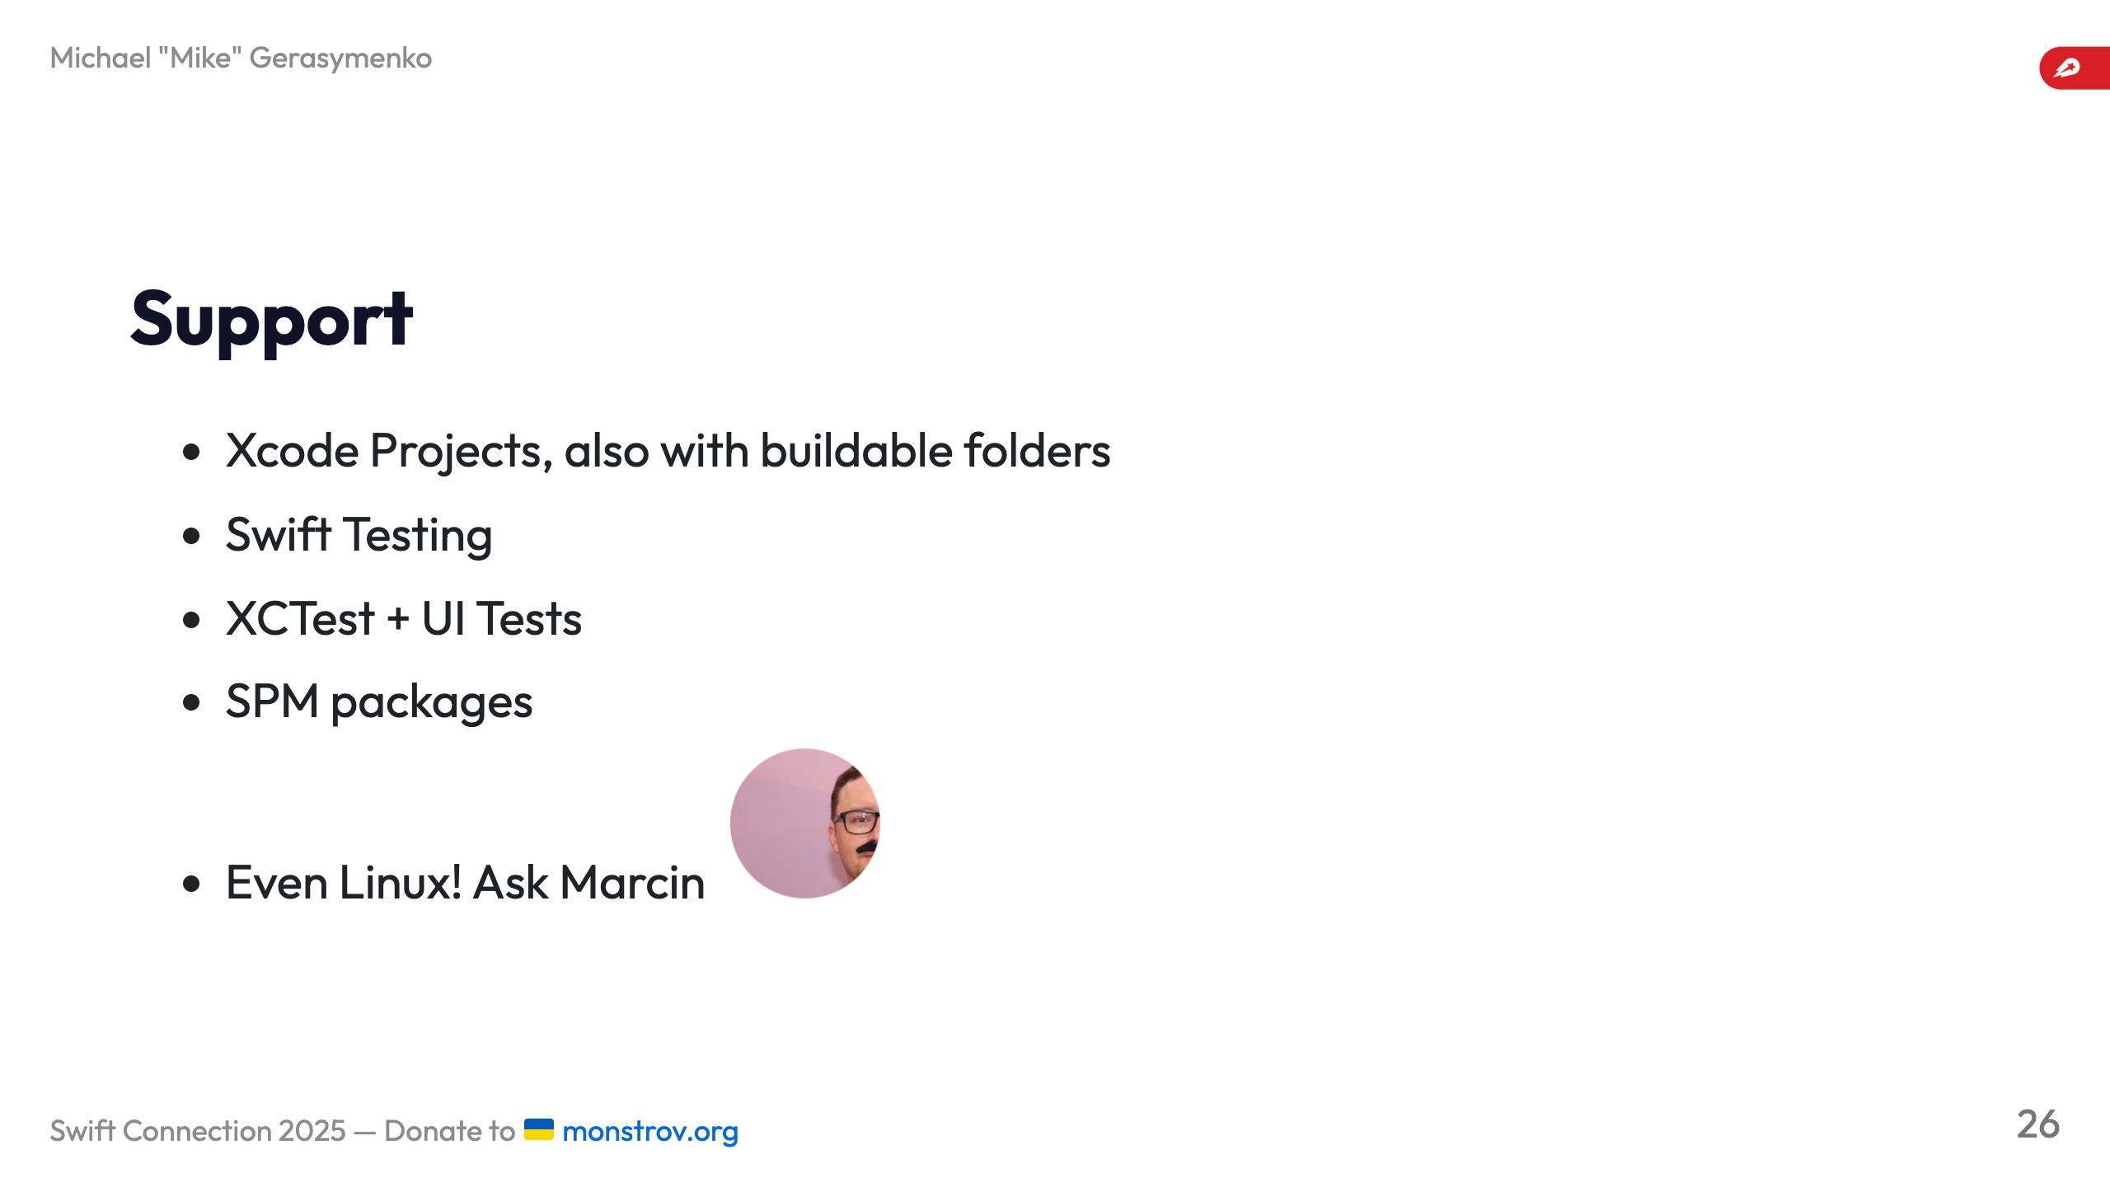

Slide 27
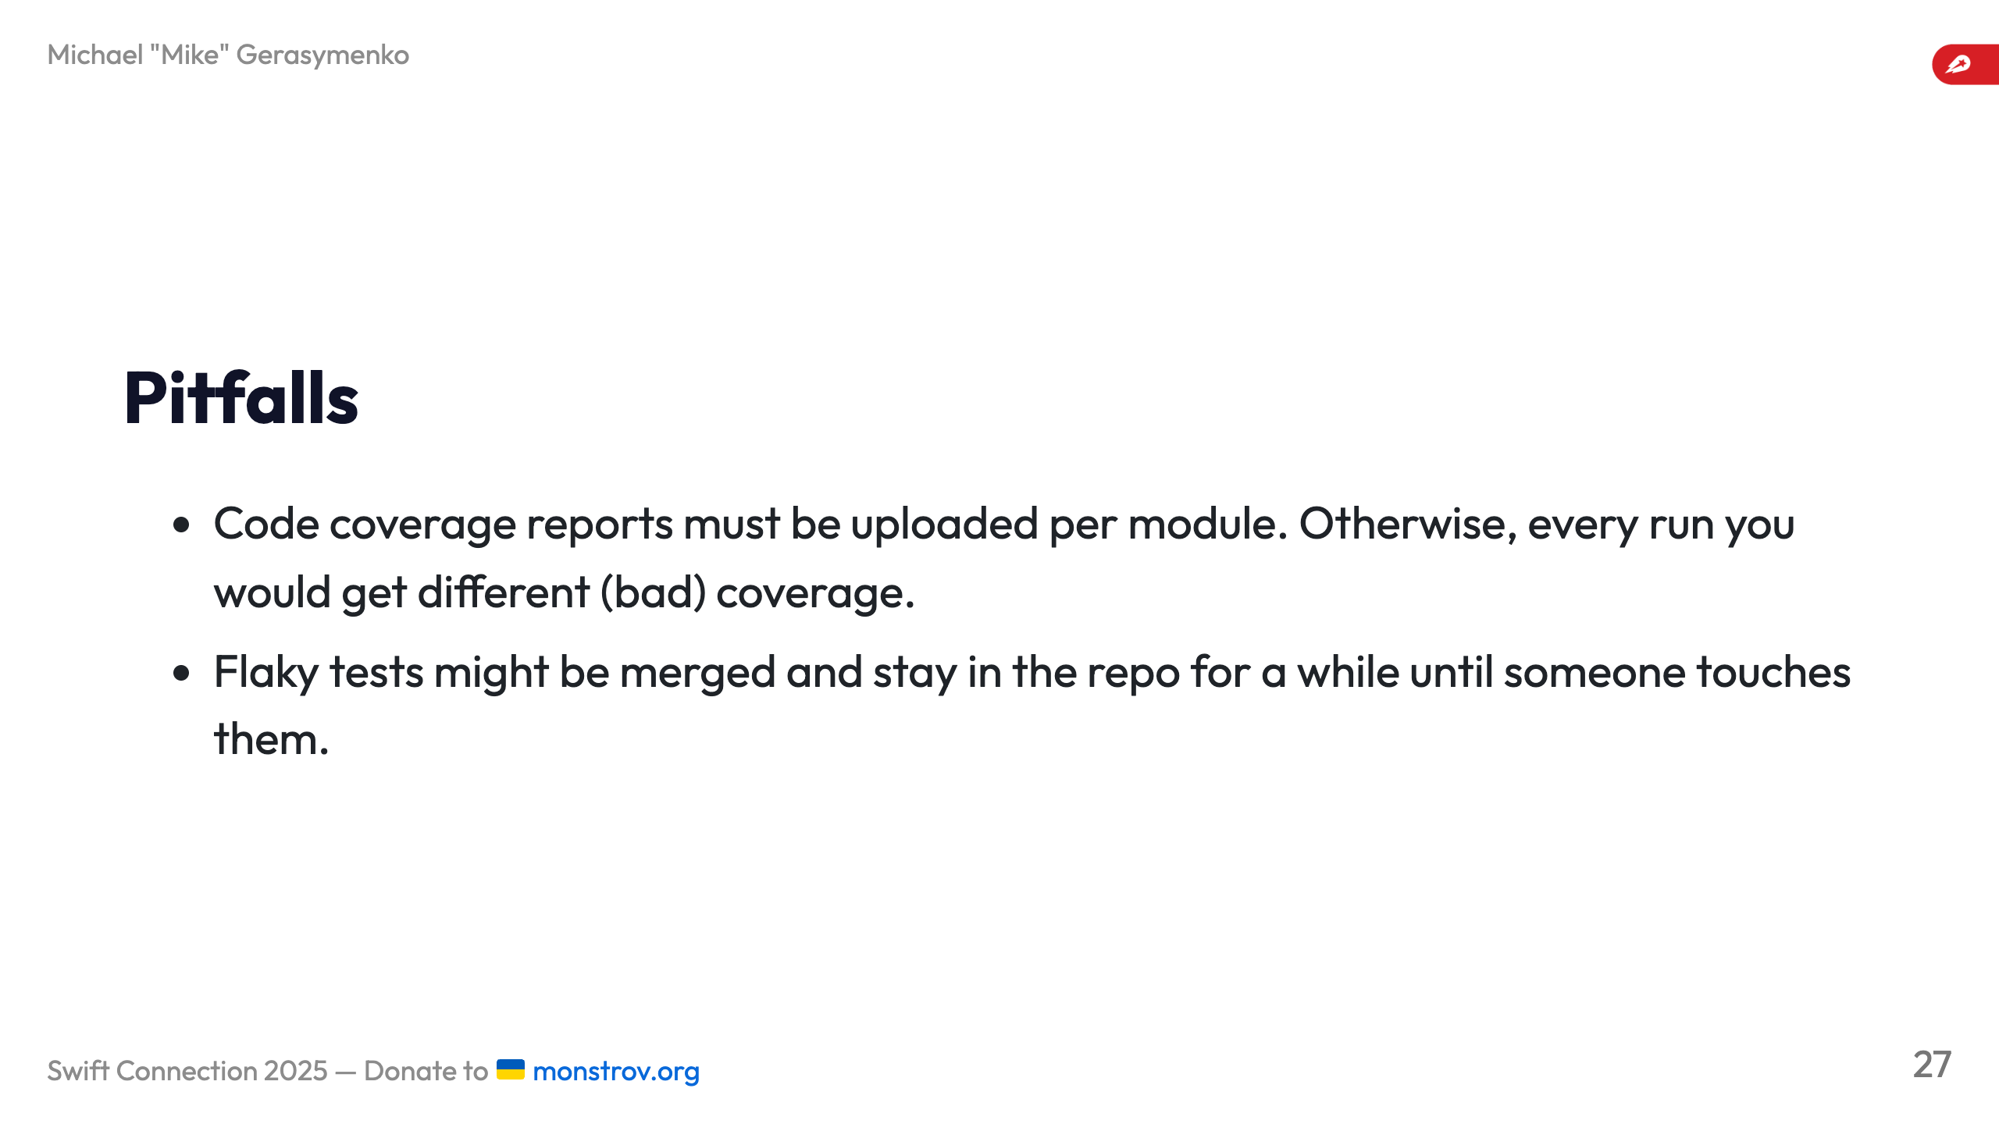

Slide 28
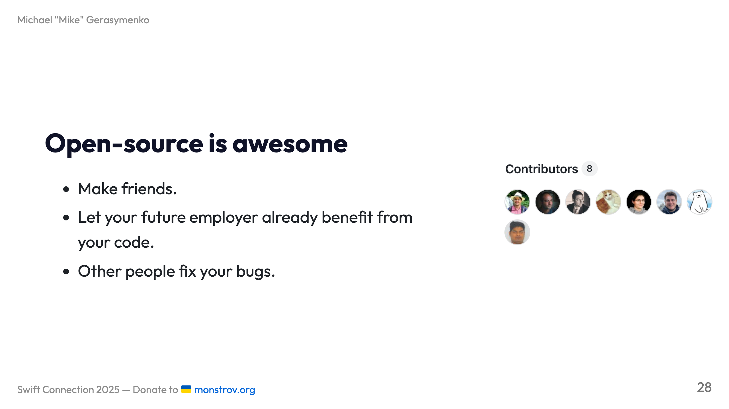

Slide 29
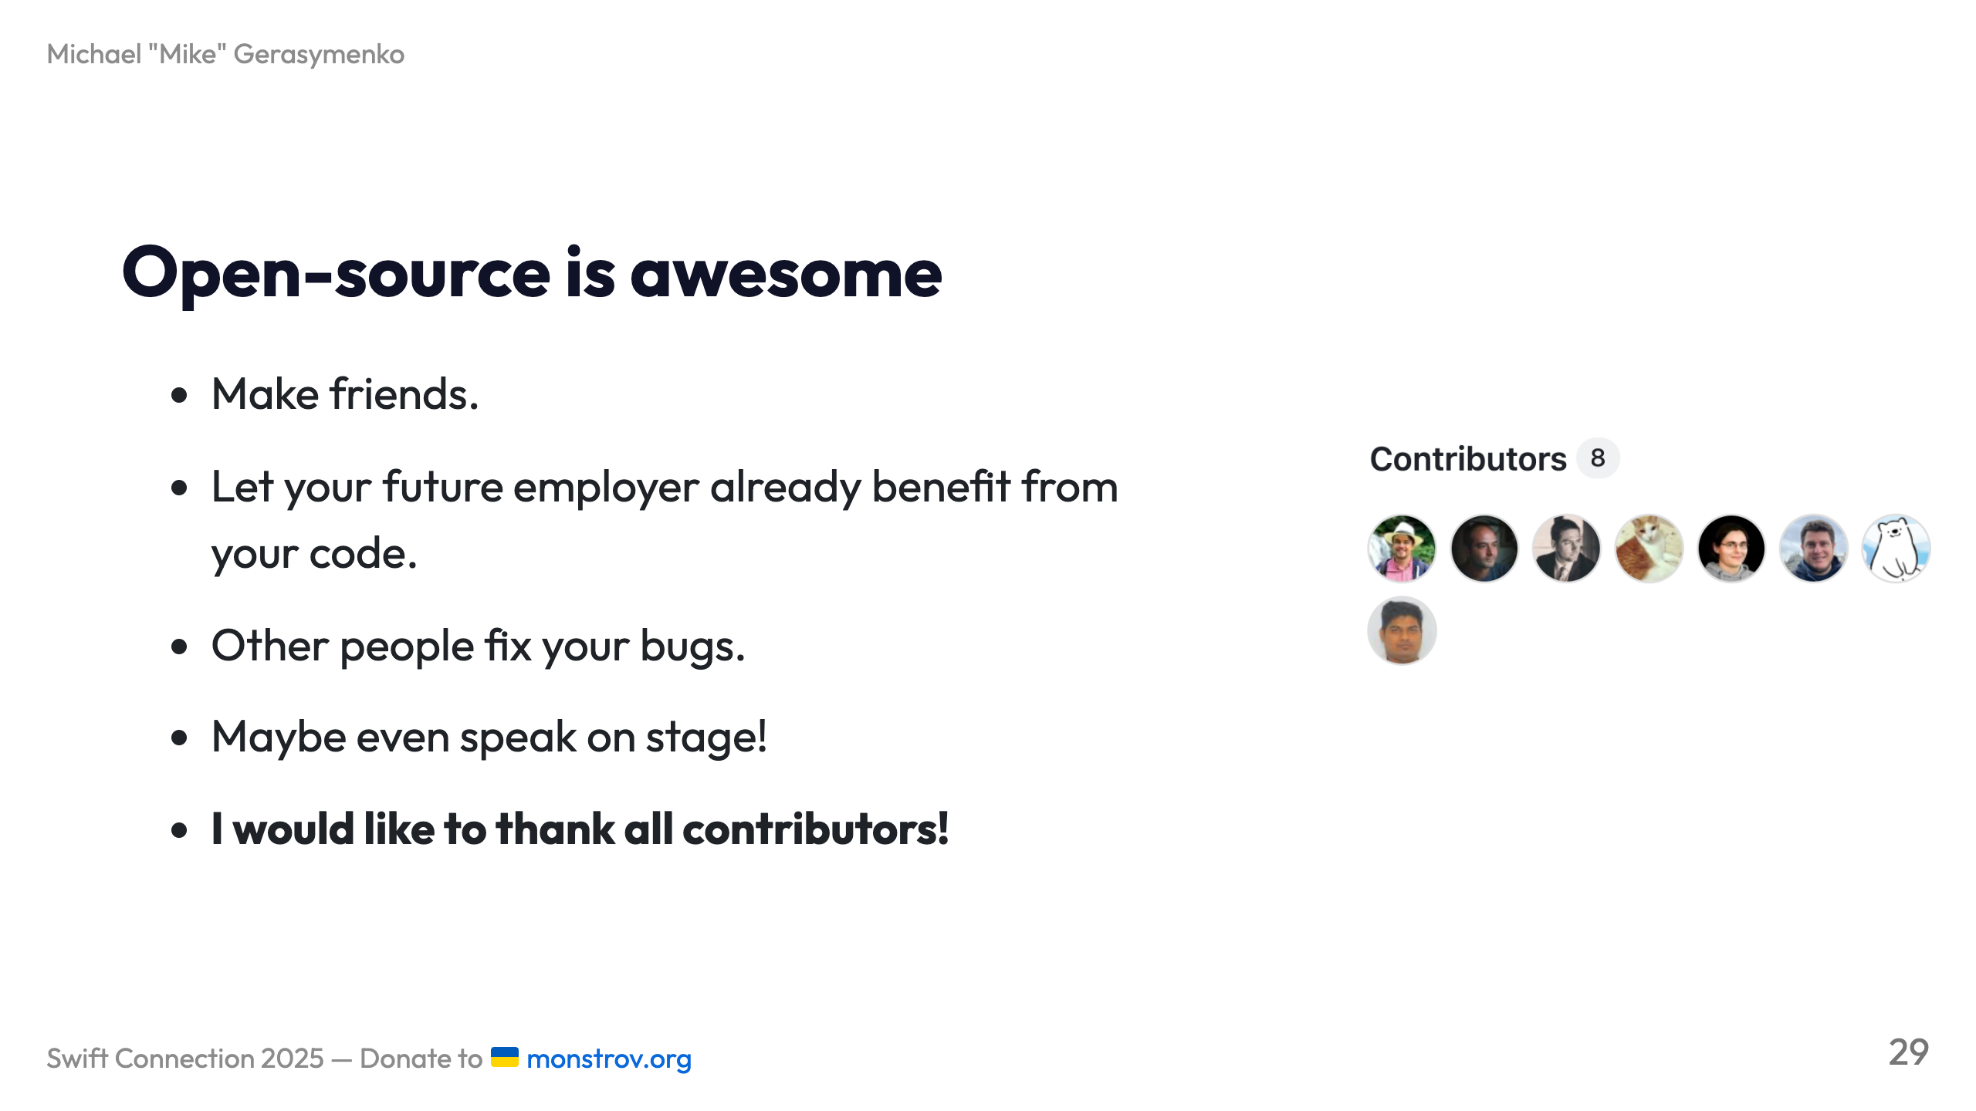

Slide 30
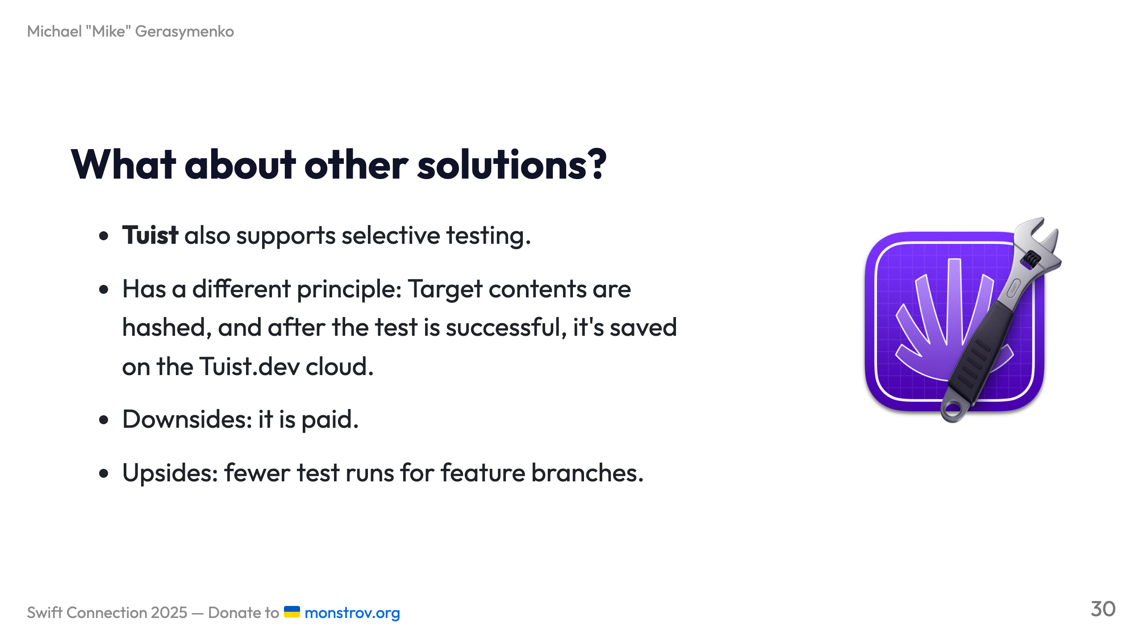

Slide 31
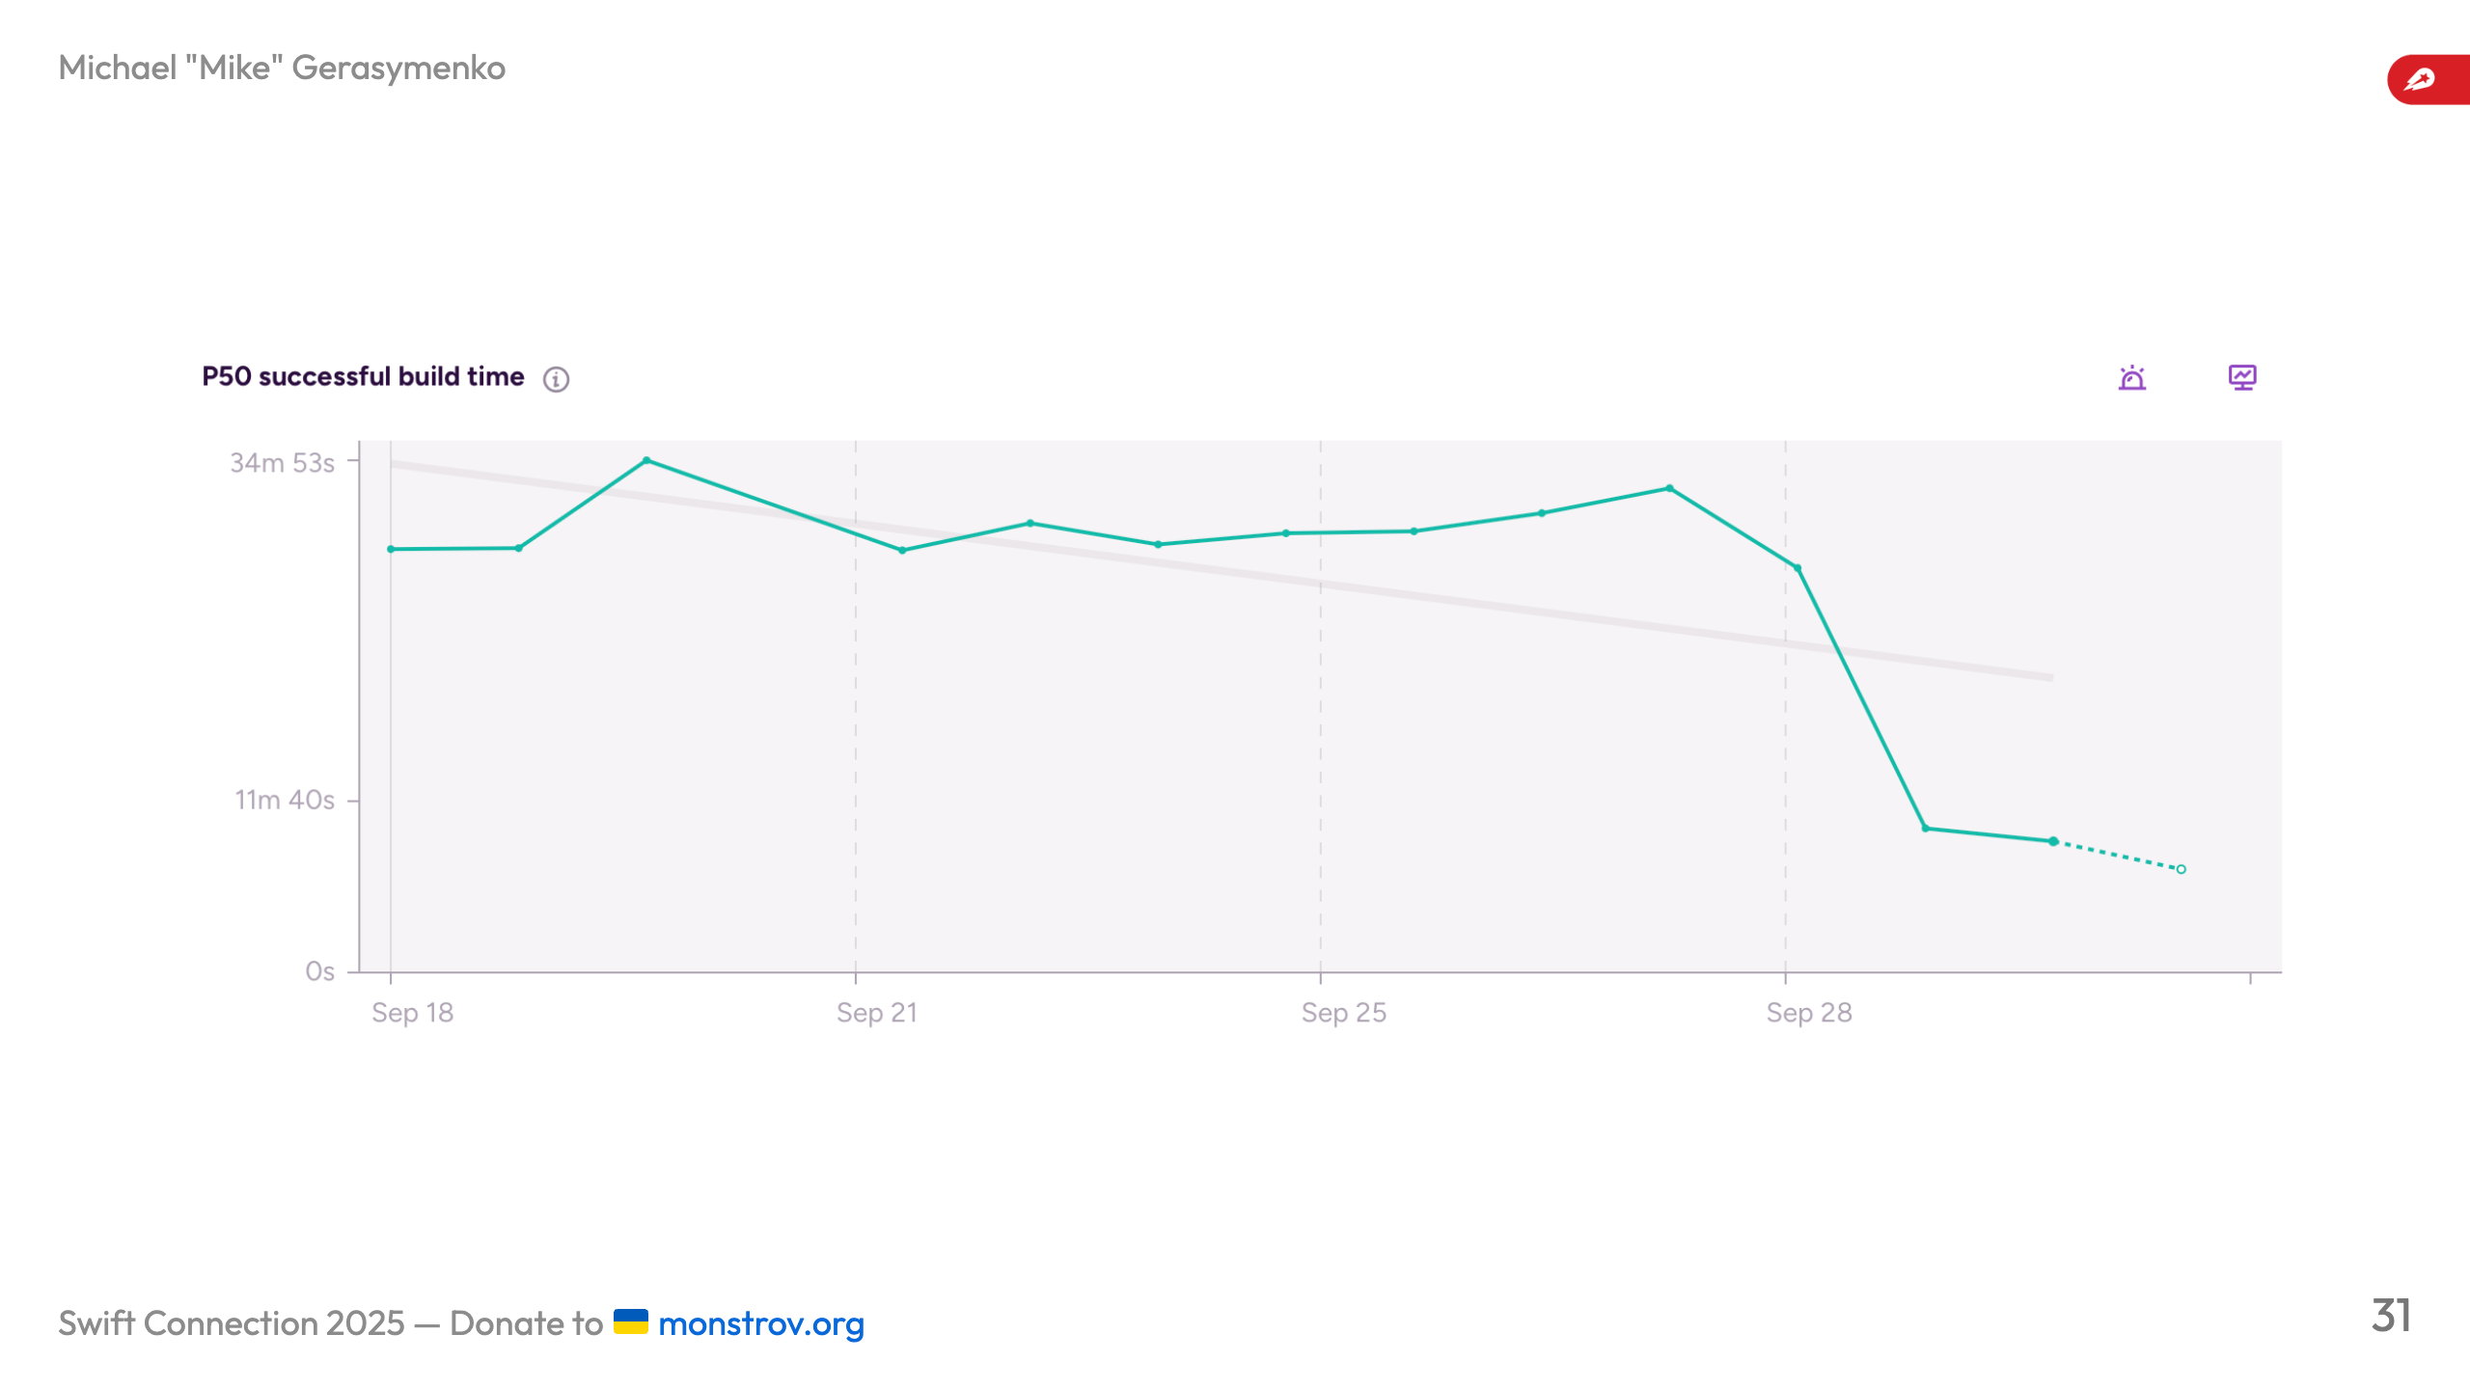

Slide 32


Slide 33


Slide 34
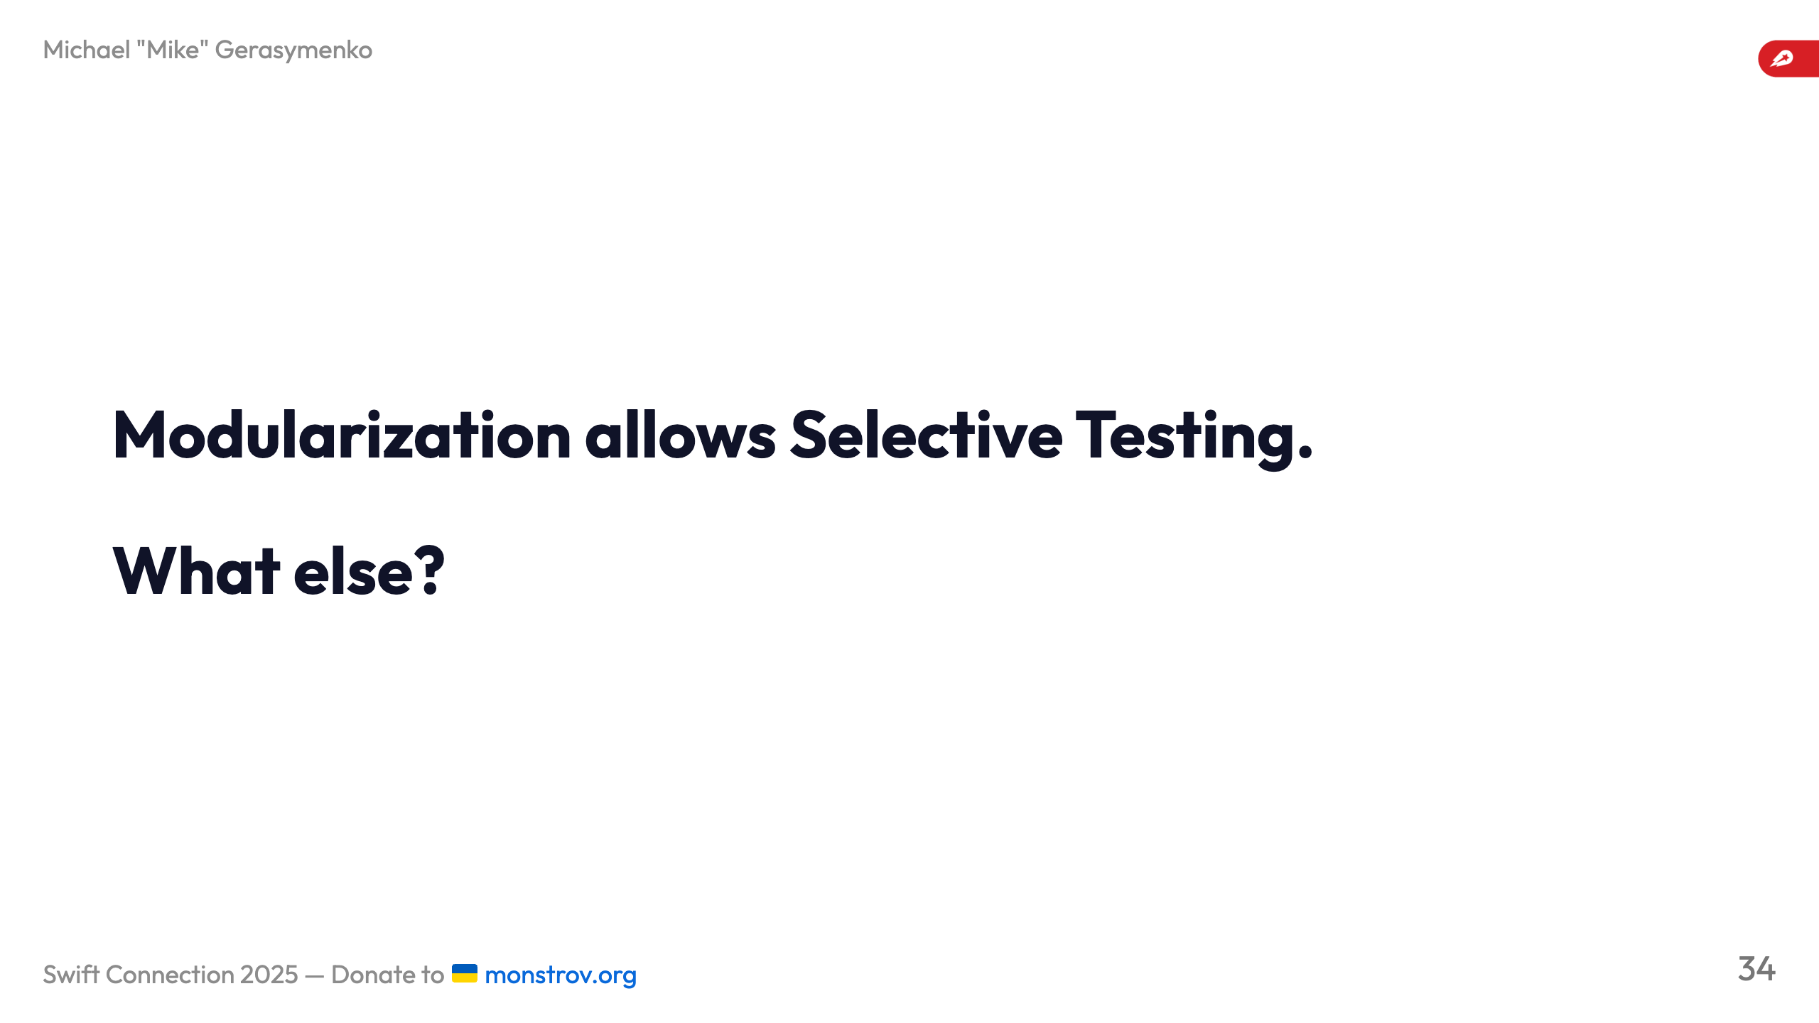

Slide 35
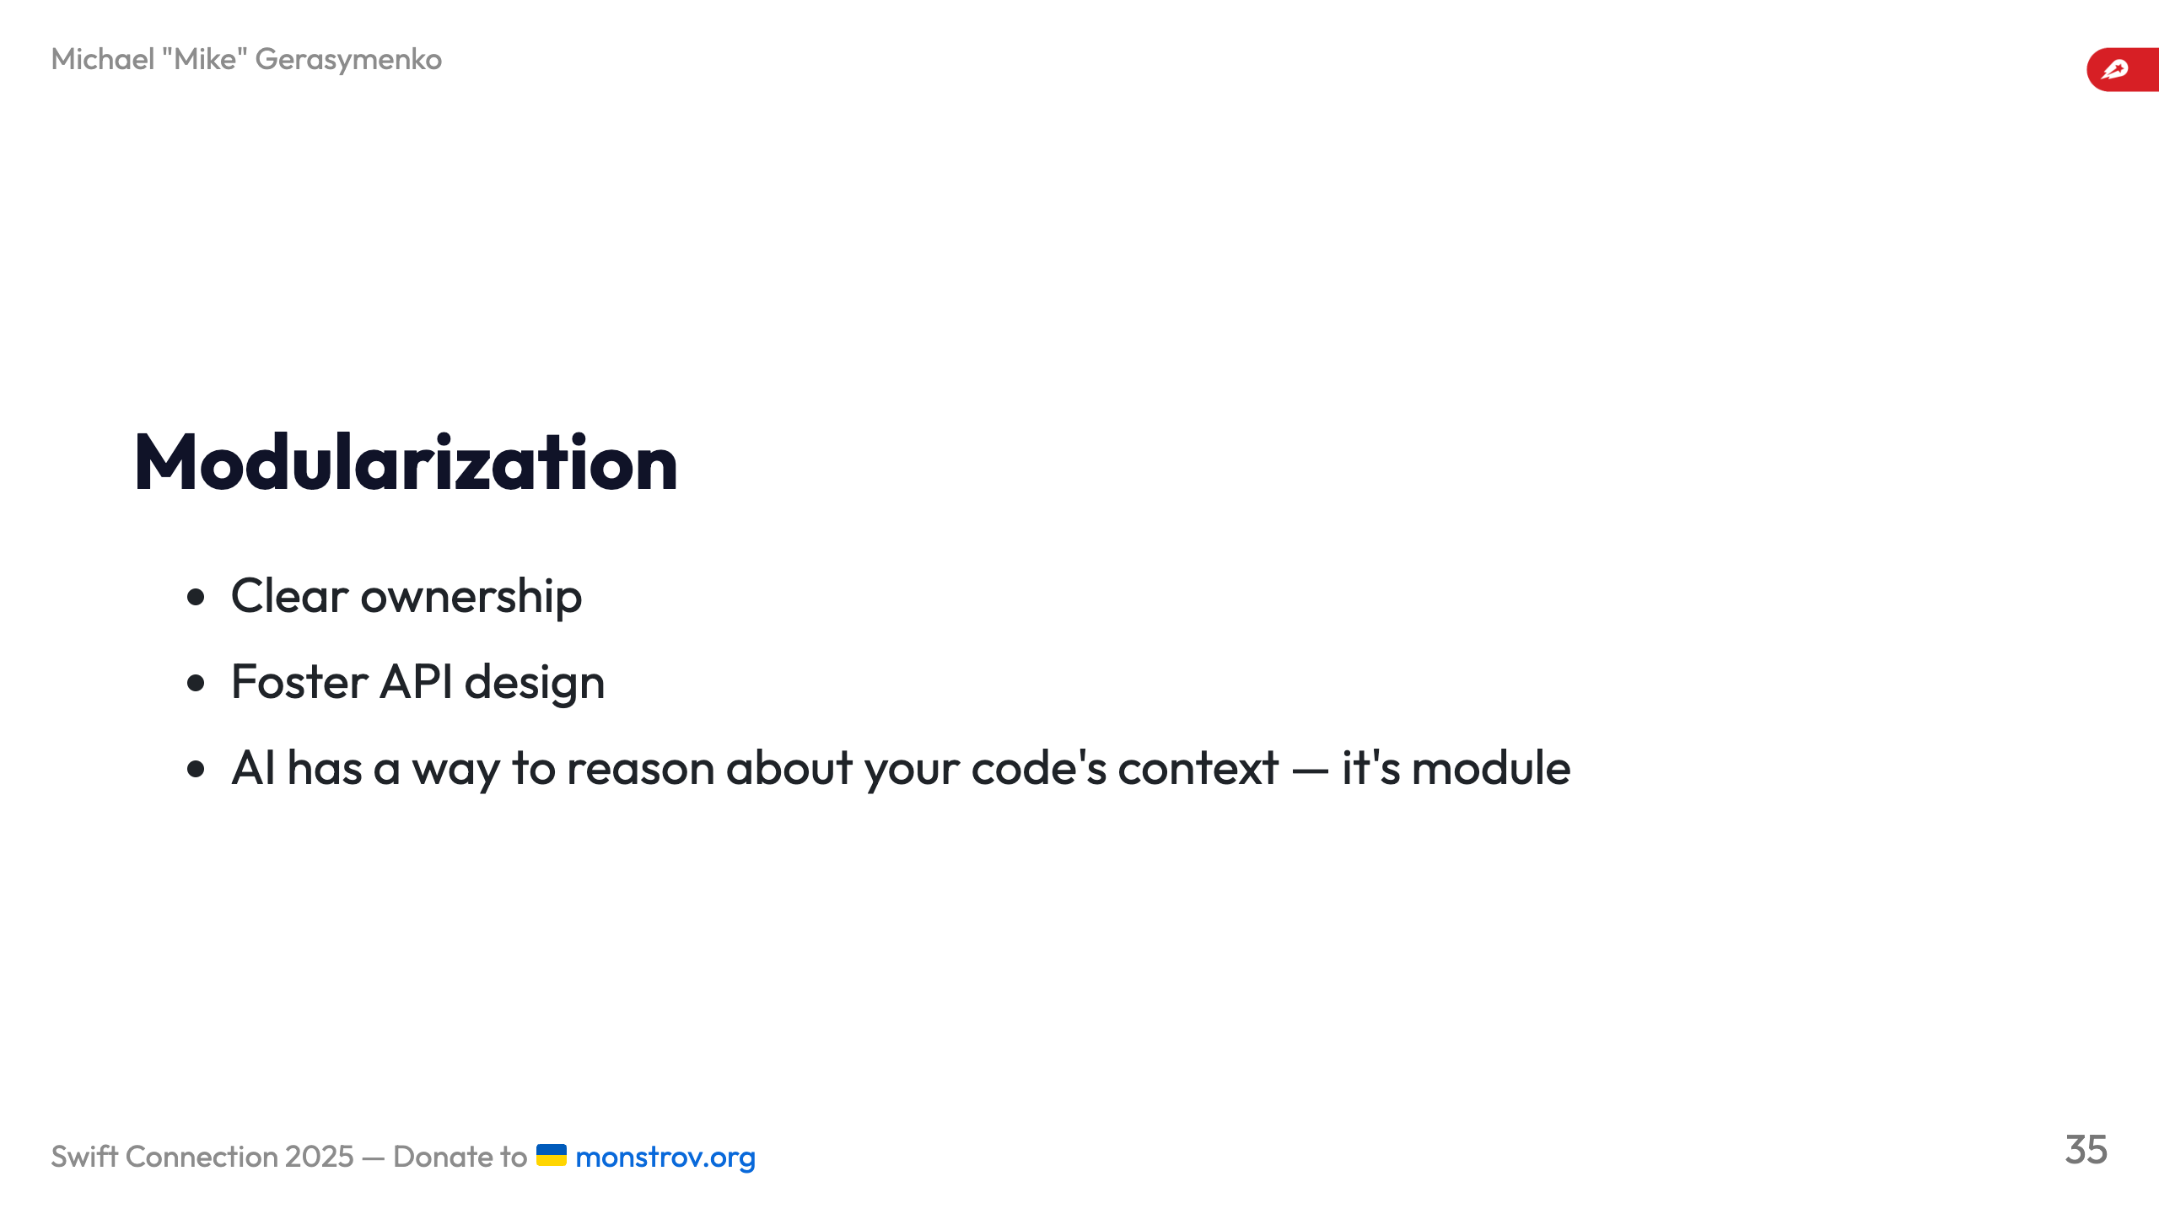

Slide 36

Notes:
AI used for proofreading Sunflower by Wolfgang Hasselmann, Gleb Paniotov --- TODO: Also, can be cut for time ![](images/scale1.png) --- ![](images/scale2.png) --- ![](images/scale3.png) --- ![](images/scale4.png) --- ![](images/scale5.png)

